Slide 1
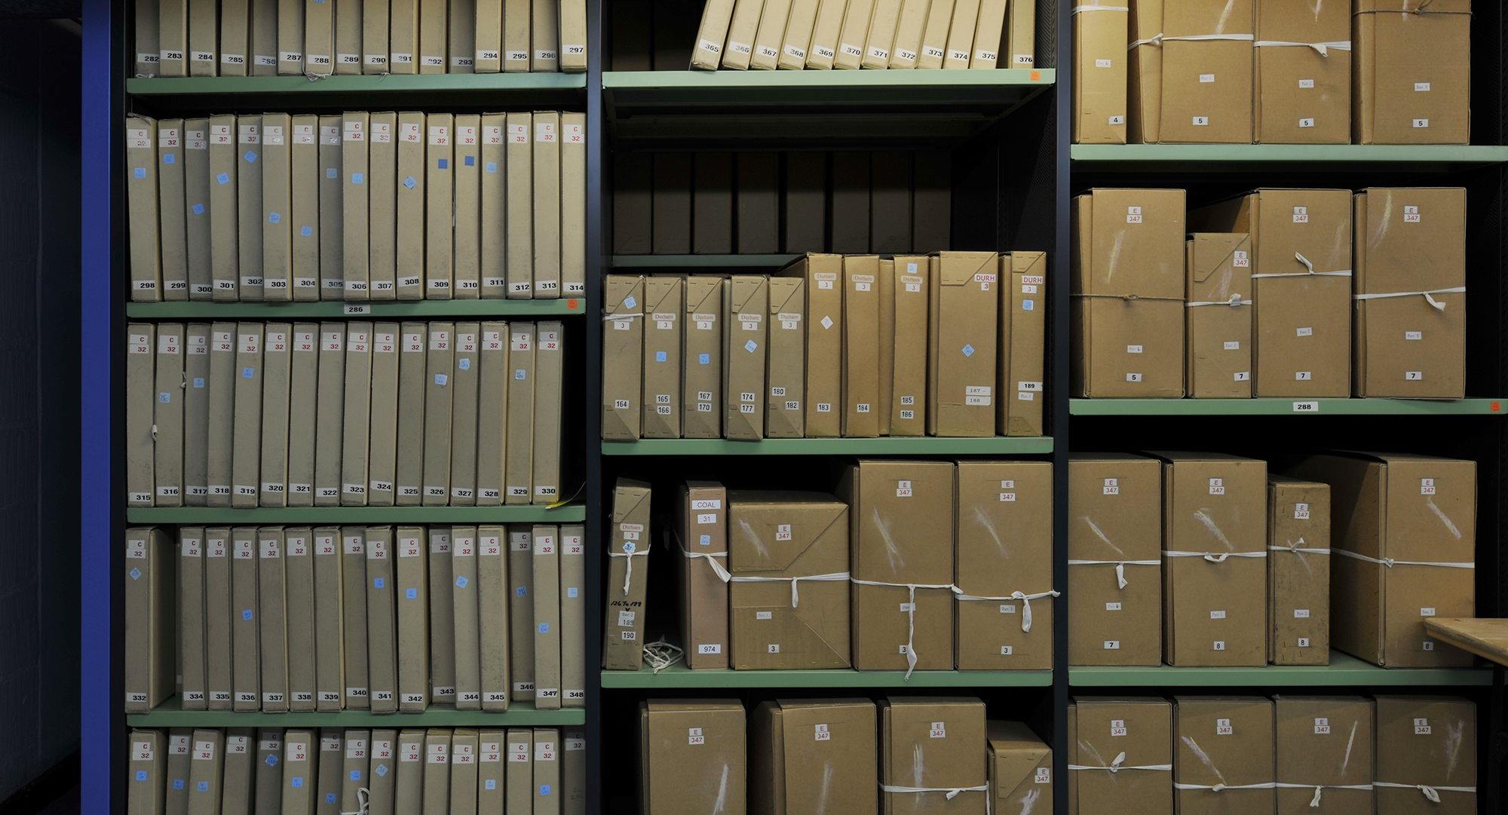
Researching 20th century Military Records at The National Archives
Dr Will Butler, Head of Modern Collections, The National Archives, UK

Slide 2
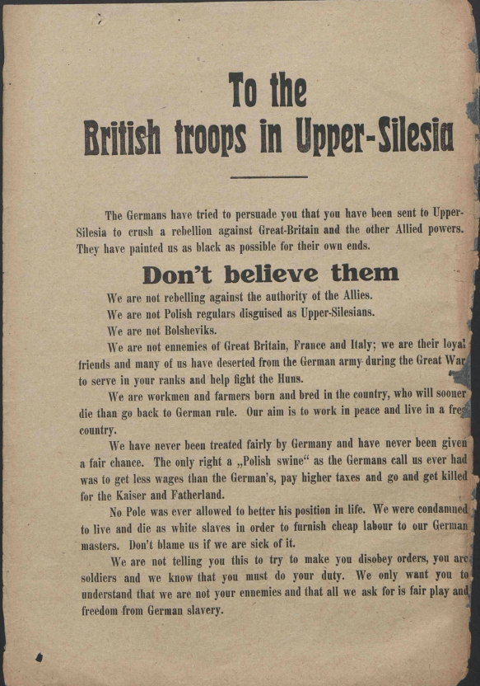
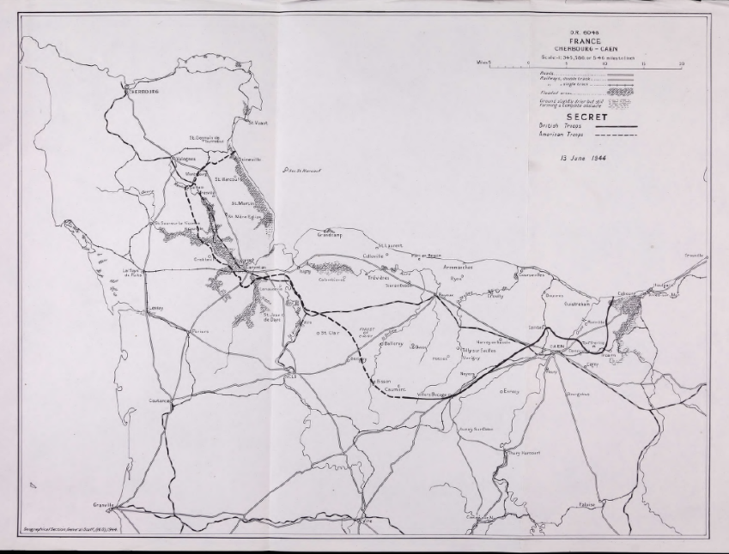
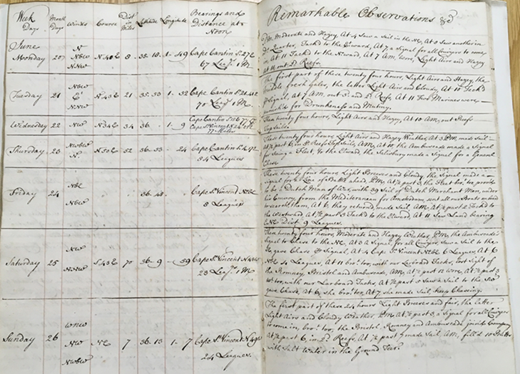
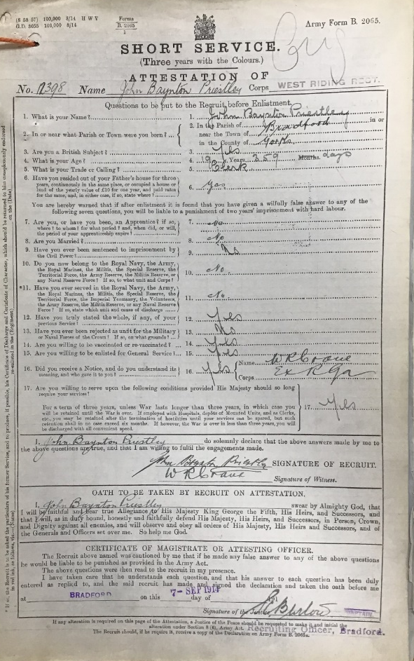
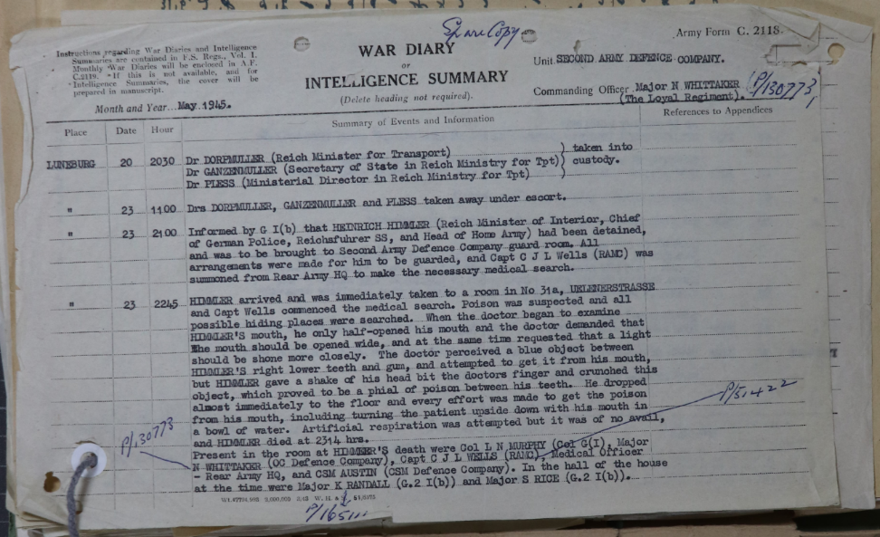
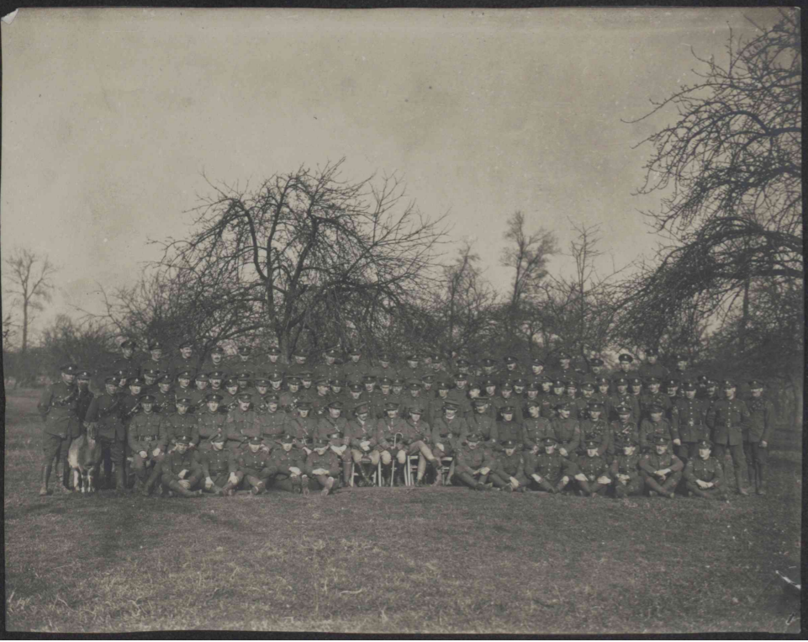
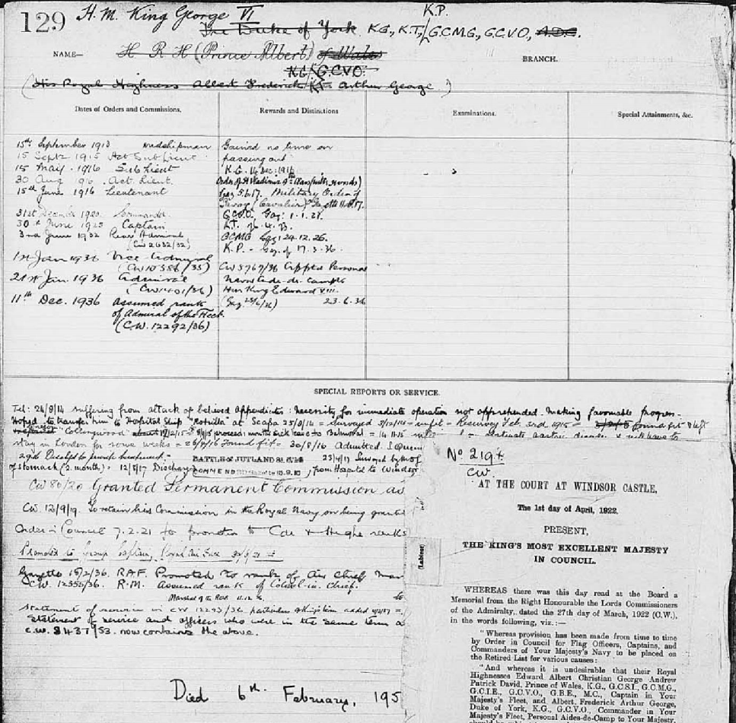

Slide 3
Types of Military Records
Broadly speaking, we can split the types of records we hold into two categories:
Personnel Records: i.e. records which relate to individuals involved in the armed forces over 300 years or so until 1963. This includes, but is not limited to, Muster Rolls (lists of individuals); Enlistment (Attestation) Forms; records of pensions and discharge; records of courts martial (military discipline and punishment); and those awarded medals.
Military Administration, Operations and Campaign Records: ‘higher’ level records which tend not to relate to individuals, but more about how military campaigns, across the centuries, have been planned, conducted, and reflected upon in the official record by politicians and military leaders. These records also reflect administrative changes in the armed forces, as well as its day-to-day running and activities at times of peace and war.

Slide 4
Records of the British Army, 1914-c.2000

Slide 5
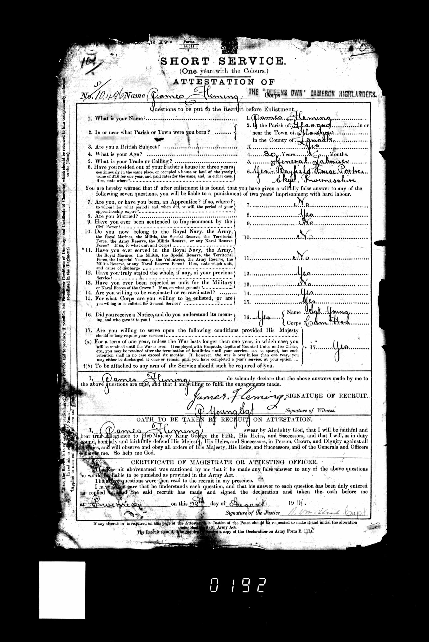
FWW Other ranks’ service records in WO 363:
Attestation papers – this may include place of birth, age, trade and next of kin
Service history including postings, regiments, and promotions
Medical history
Information on conduct

Slide 6
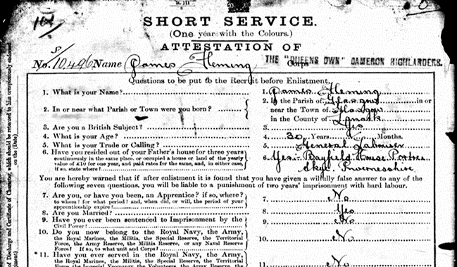

Slide 7
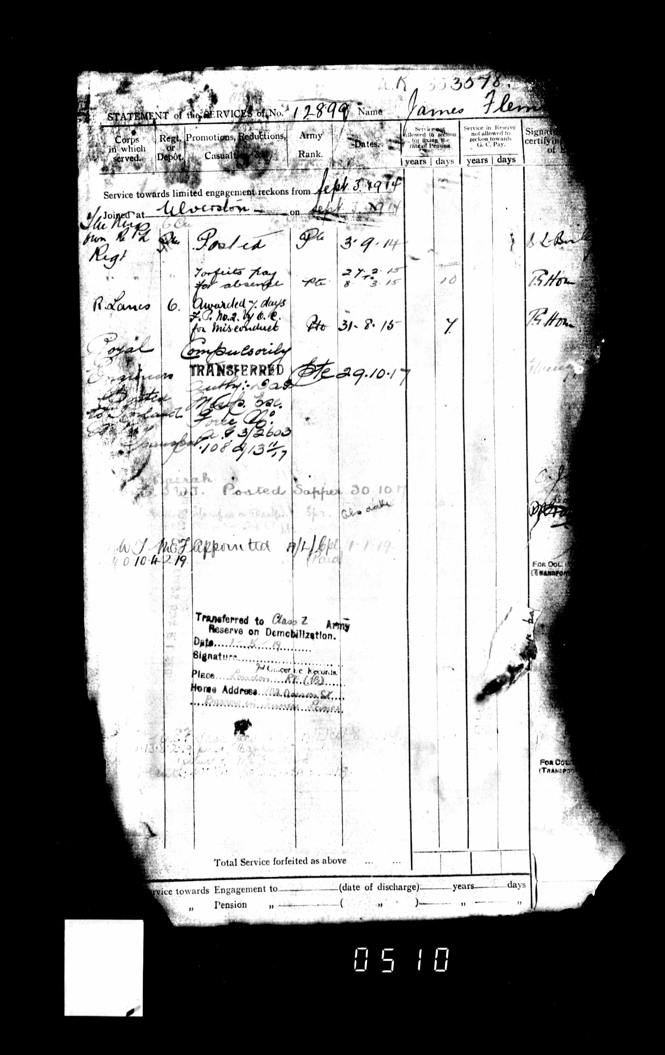
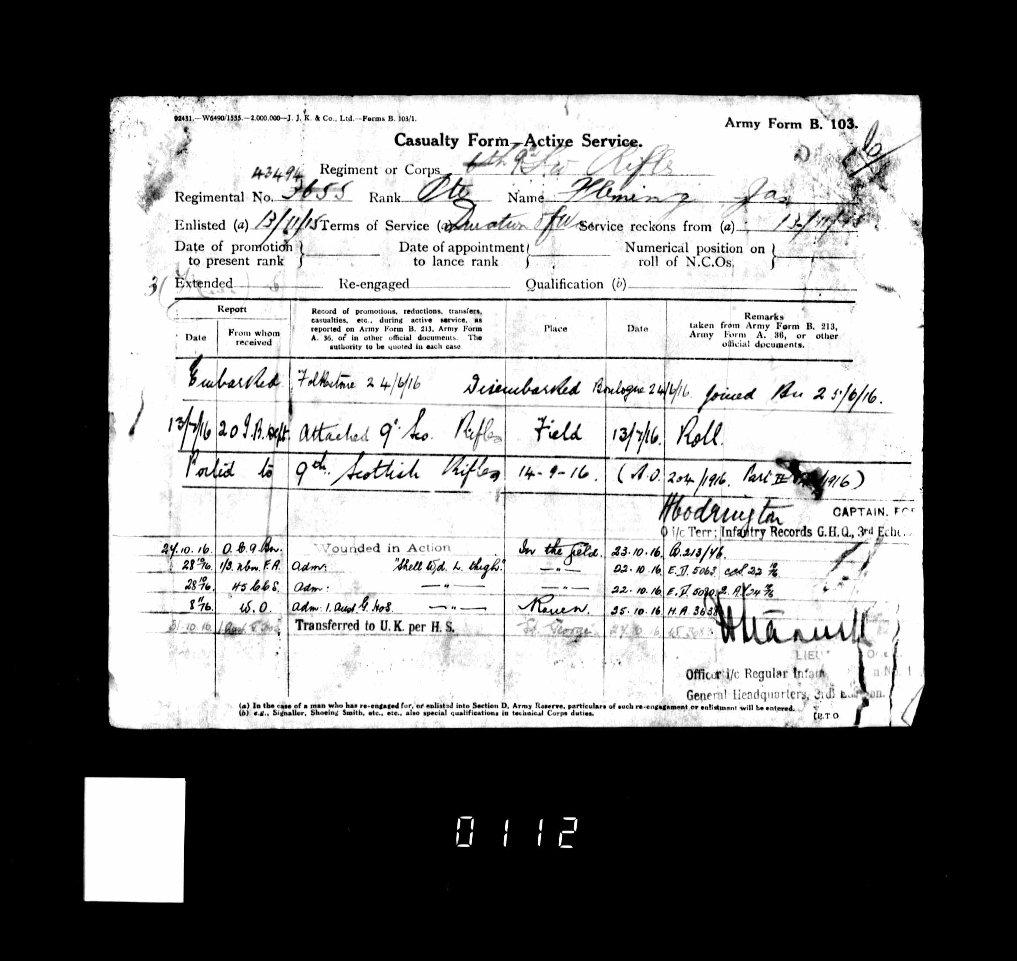

Slide 8
Other other ranks service records…
Records for the Household Cavalry between 1799 and 1920 are digitised and available on our website in the series WO 400 – that’s a further c.8,000 men for the First World War.
Guards infantry regiments (Grenadier, Coldstream, Scots, Irish, Welsh and Machine Gun Guards) are part of the MOD Service Record transfer to TNA

Slide 9
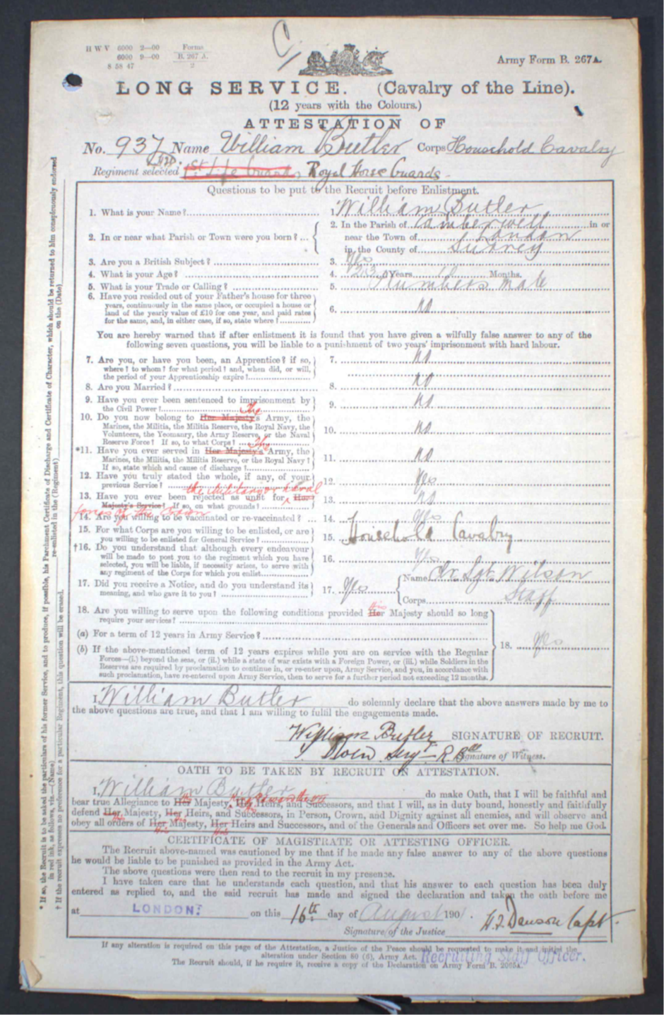
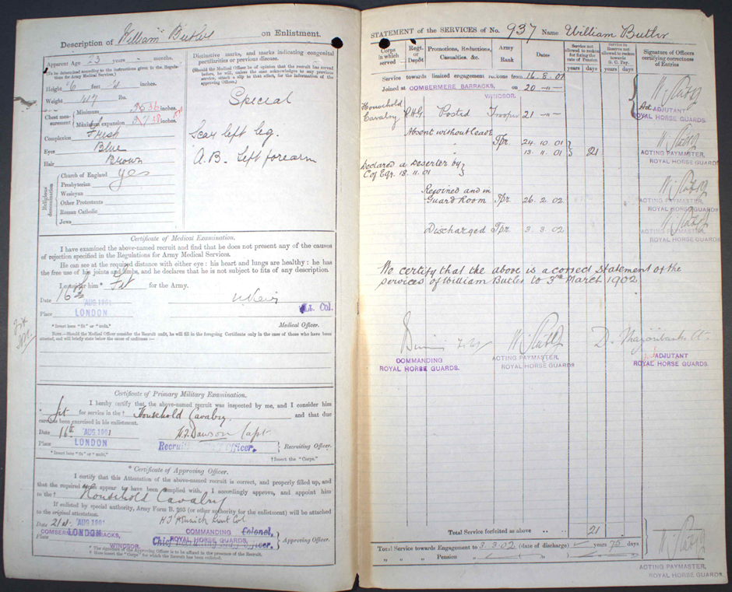
WO 400

Slide 10
Other ranks pension records
WO 364 contains the pension records for other ranks
Name-searchable and downloadable on Ancestry.co.uk
Contains very similar information to a Service Record (including attestation papers, statement of the services etc)
Difference to WO 363 is pension records should provide information relating to a cause of discharge (and thus reason for pension)

Slide 11
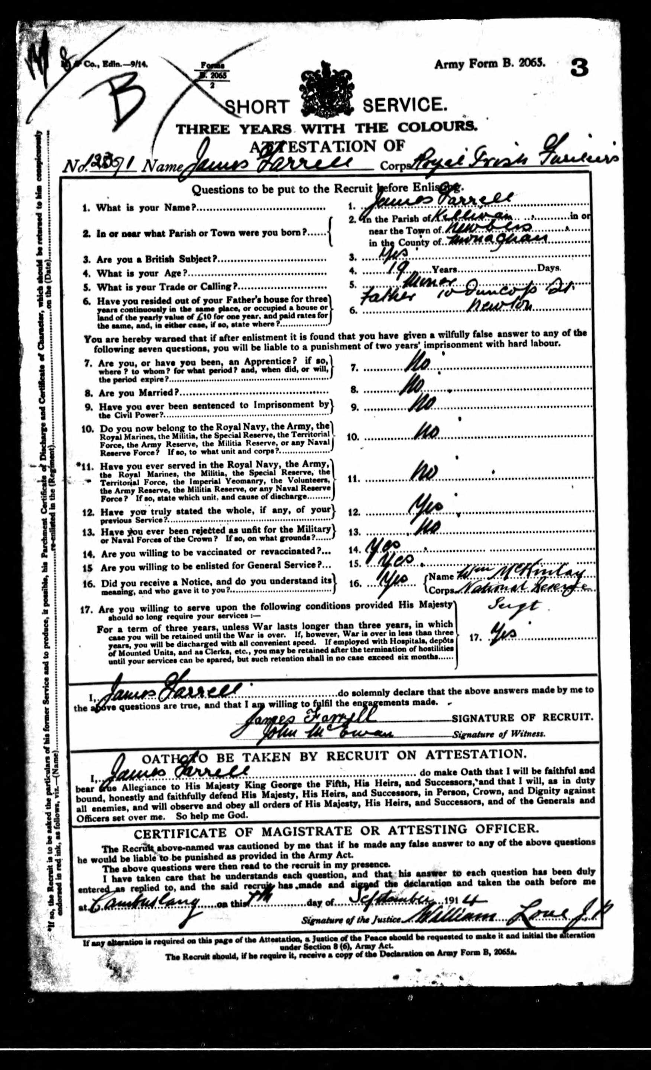
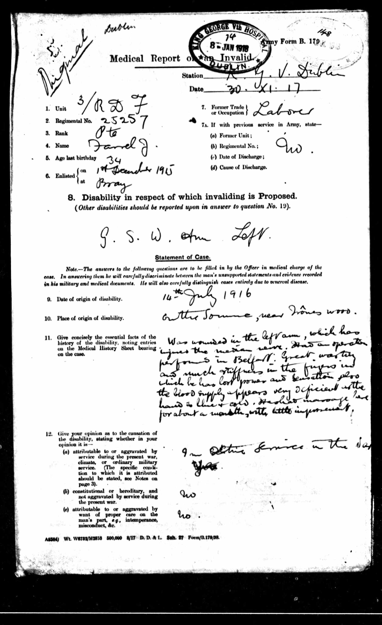
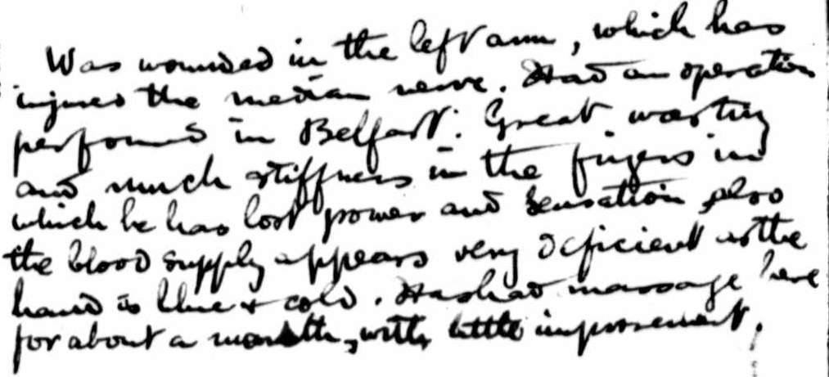


Slide 12
Important to Note:
The personnel records for the First World War only cover the period up to 1921. Not included in these records, are any for those who continued to serve in the army beyond this point.
So, for example, if an individual decided to re-enlist at the end of the First World War in order to continue their service, you will not find their information in these records.
These records are part of the MOD Service Records transfer – more later

Slide 13
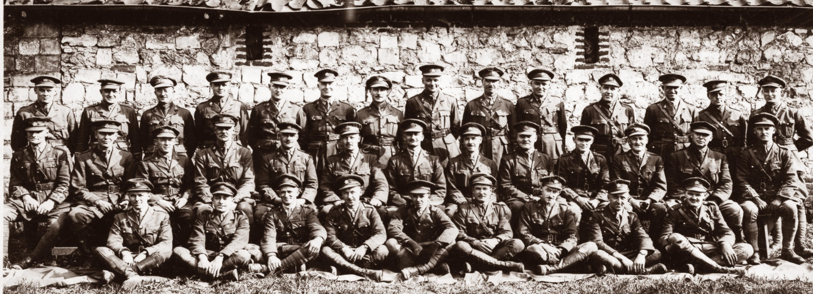
First World War officers service records
Not available online
Often refer more to a officer’s pensions & estates rather than operational aspects of their military career – vary massively in size
Found in three records series: WO 339 / WO 374 / WO 138
See guide: British Army officers after 1913
WO 95/3831

Slide 14
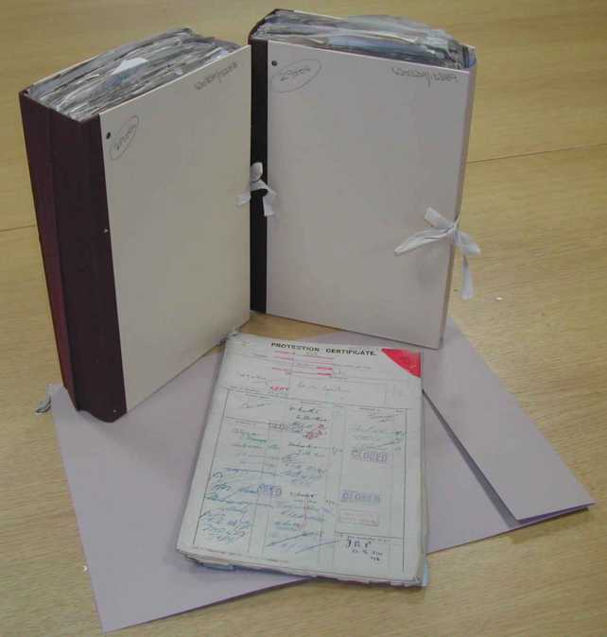
Maj. Sir Francis P. Fletcher-Vane
(WO 339/13388 & 13389)
Lt. Michael Guthrie
(WO 339/70740)

Slide 15
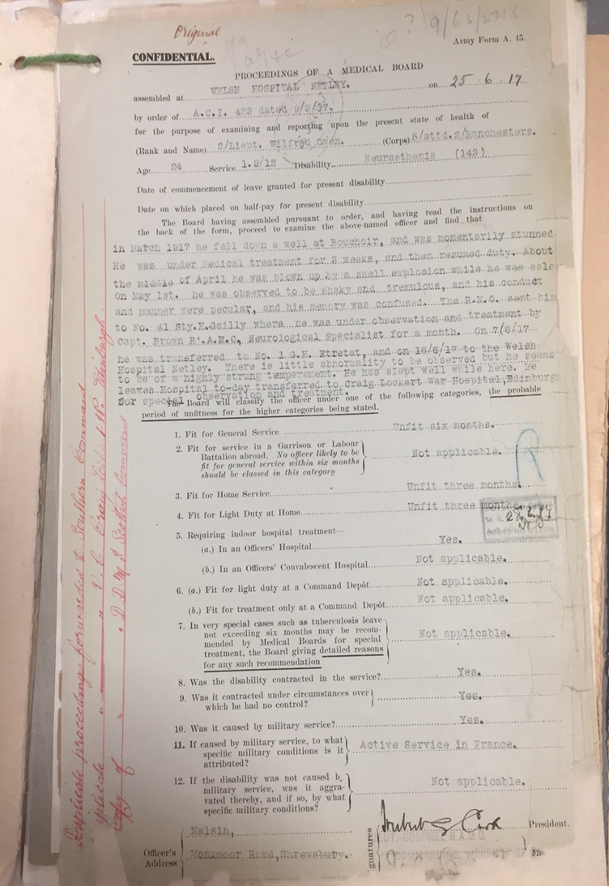
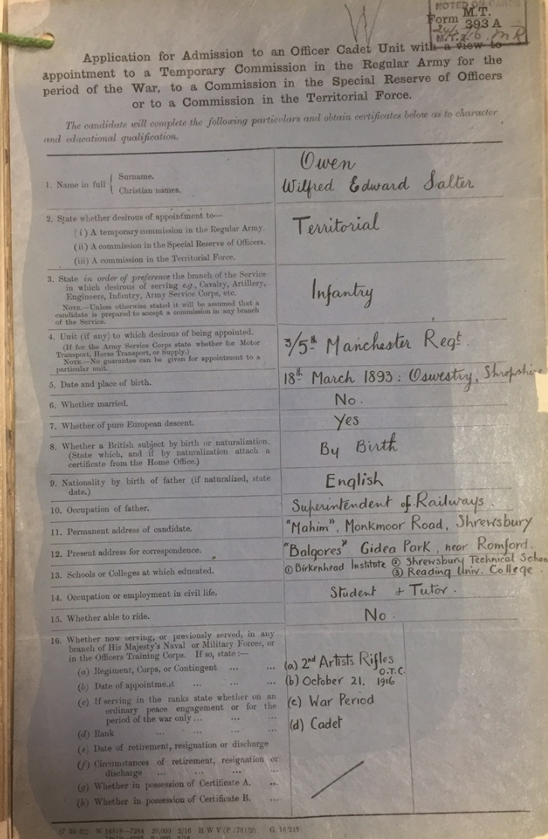
WO 138

Slide 16
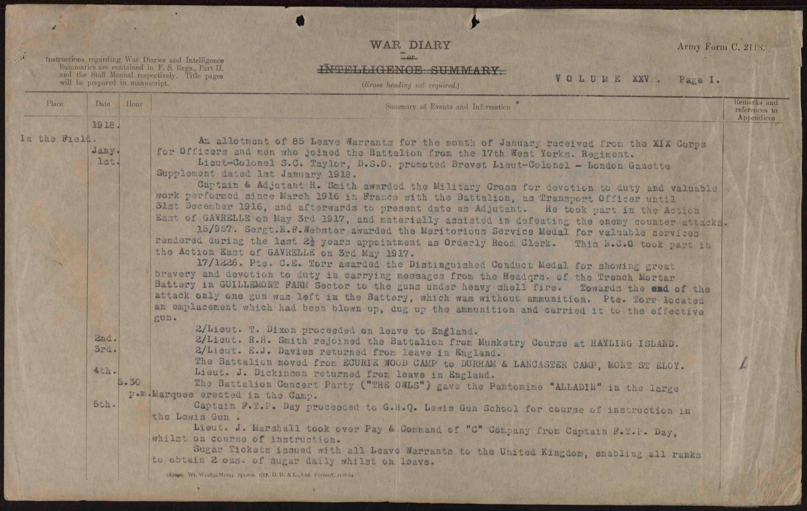
Unit War Diaries
Found in WO 95 and many available online
Great way to find out what a unit was doing at any given time
Doesn’t always contain details about individuals
BUT can contain information not found in other records

Slide 17
Unit War Diaries
Army units include battalions, regiments, brigades, and divisions, and you can search diaries at each of those levels.
Combatant and non-combatant roles, including depots, transport, etc. which can also be searched
The diaries were compiled during hostilities by units and headquarters so it is possible to obtain a more strategic view of an operation, as well as a view as to what happened ‘on the ground’.
Contents included narratives, orders and intelligence summaries.

Slide 18
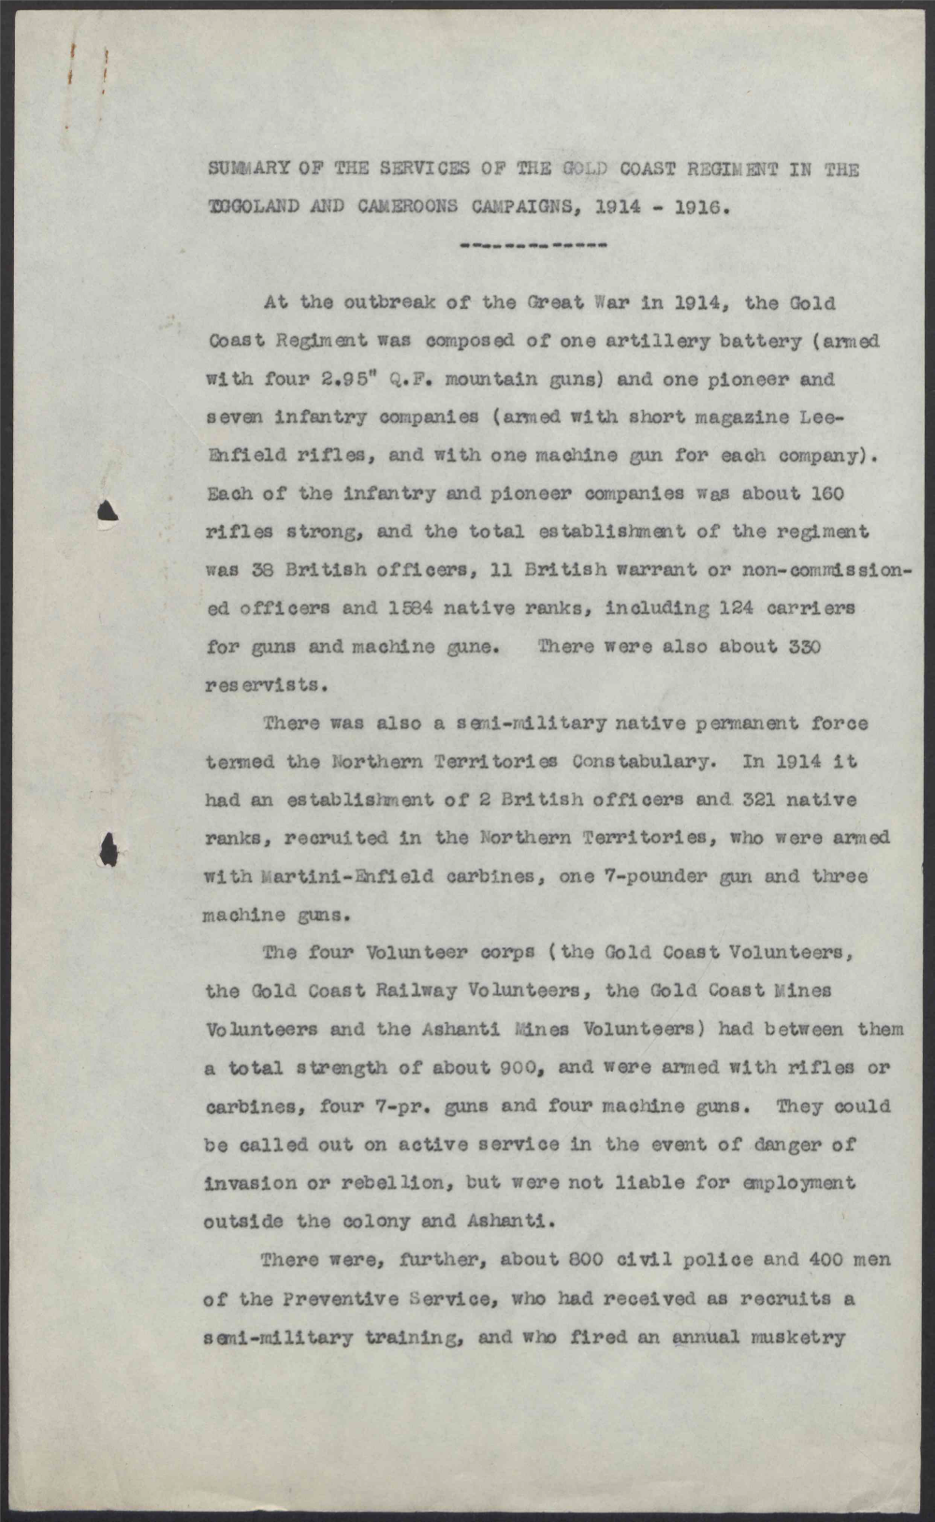
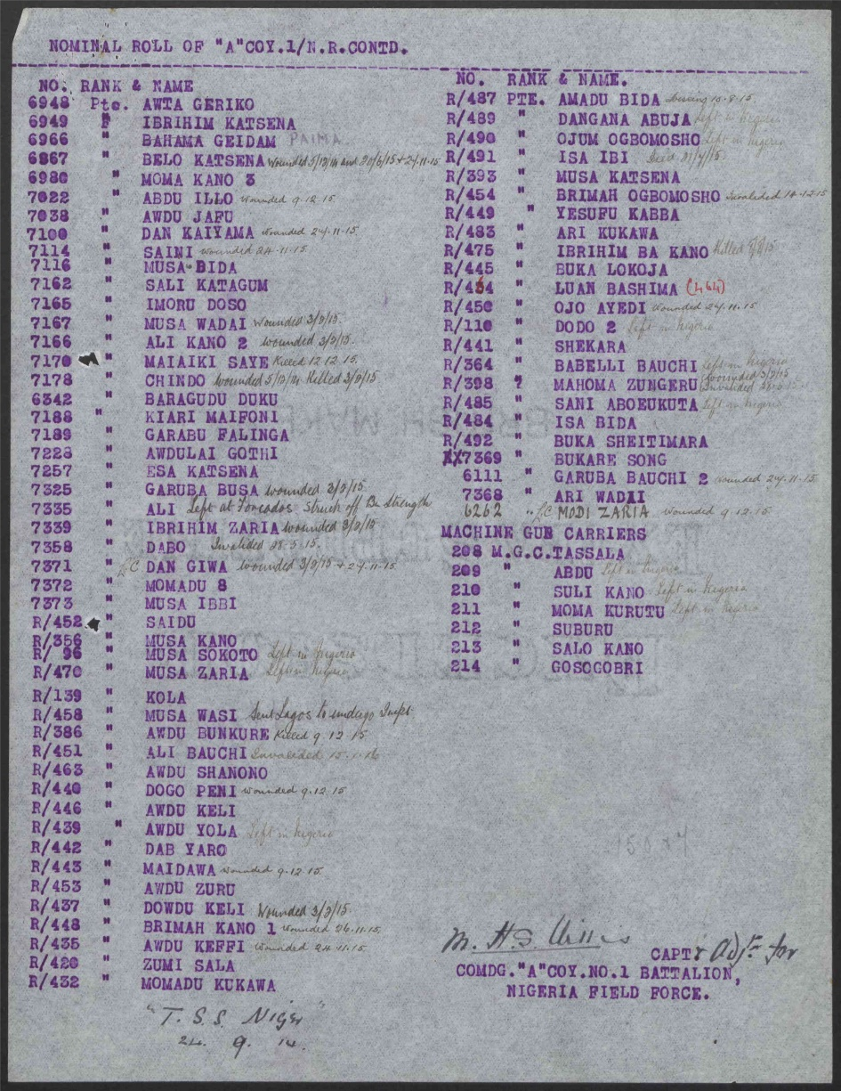

WO 95/5387 and WO 95/5388

Slide 19
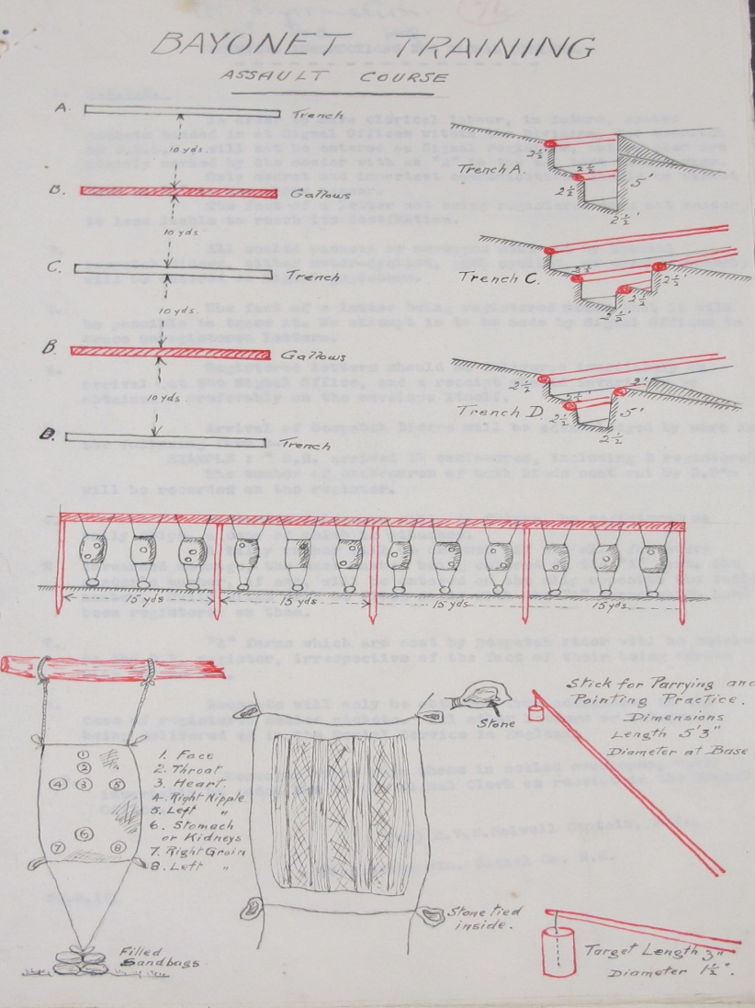
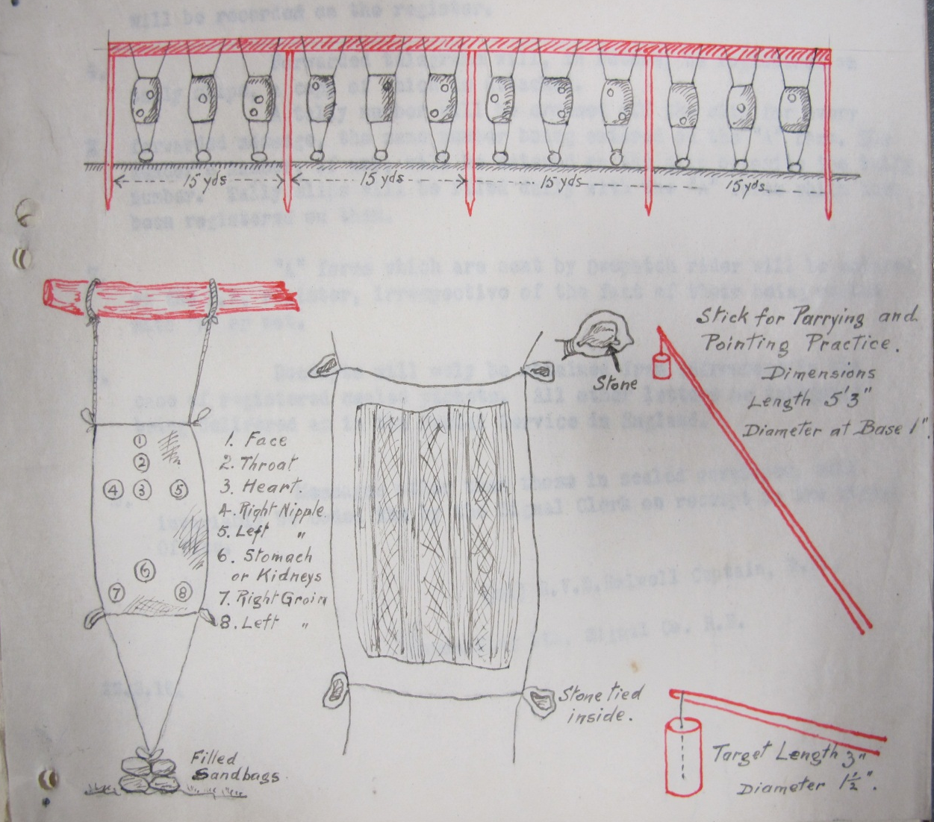
WO 95: Training insights
WO 95/1513 – 5th Division HQ: General Staff (March 1916)

Slide 20
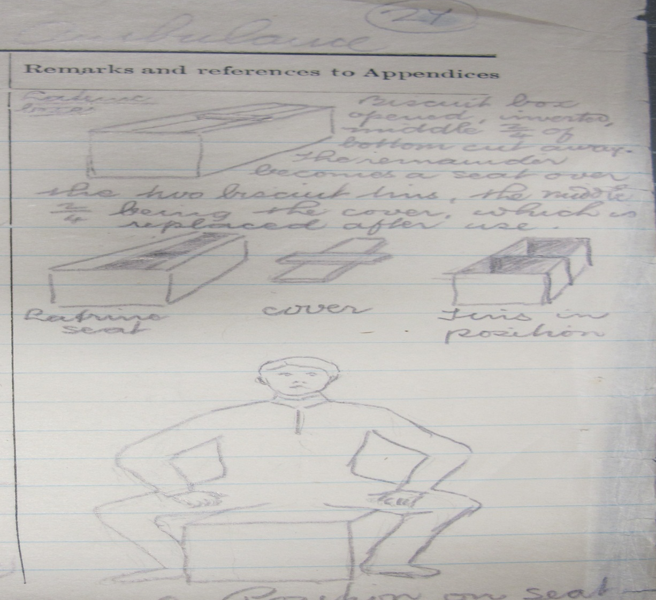
WO 95: Army life/conditions
WO 95/1703 – 24th Field Ambulance, 5th Division (July 1915)

Slide 21
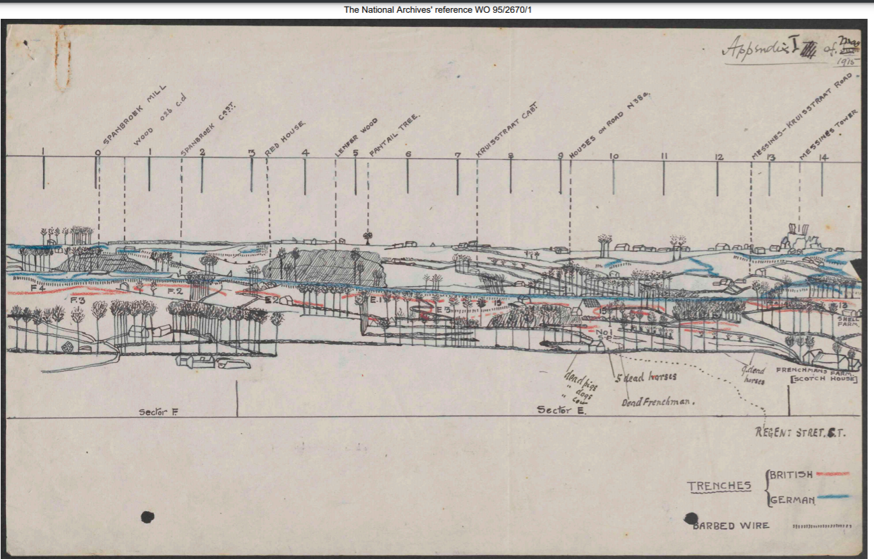
WO 95/2670/1 Sketch of Messines Ridge May 1915

Slide 22
Post-1920 Army Service and MOD Transfer
Estimated 12 million records (though number likely to be much higher!)
To put into context, the collection has a linear meterage of around 50km. In one year, The National Archives will typically accession approximately 1.5km of paper records. The entire collection of service personnel records is equivalent, therefore, to 20+ years’ worth of annual accessioned material
The project to transfer the full collection of records will run to March 2027, and began in early 2021
So far, 6 million Army records have been transferred to TNA, and are being prepared for opening to the public, relating to service from 1920-1963
c.900,000 of the records are available to search by name, service number, and DOB on Discovery. If it can’t be found then webforms can be found in the British Army soldiers during the Second World War research guide

Slide 23
Scope of the Records
The records cover an individuals’ service in the Royal Navy, Army and Royal Air Force, where the individual has a discharge date prior to 31 December 1963 (end of National Service).
They include around half a million FWW service records (i.e. those who continued to serve after 1920); and records of those who served during the interwar period.
As you might expect, the biggest collection relates to those who served during the Second World War.
Does not only include ‘domestic’ military records: also includes selected records from Egypt, Cyprus, Kenya, Palestine, Mauritius, and East Africa.
Organised over 75 different ‘collations’, based on MoD filing system.

Slide 24
Accessing the records already at Kew
The records catalogued can be searched by initial, surname, date of birth, and/or service number on Discovery
They are available to view in the reading room if the DOB is 115+ years. Readers can make FOI requests to open records before this date if they can prove that an individual is no longer alive
Members of the public are often referred to us by MOD if the latter know that the record has already been transferred to us, and the public can make a request to us directly.
RAF records to commence transfer towards the end of 2024

Slide 25
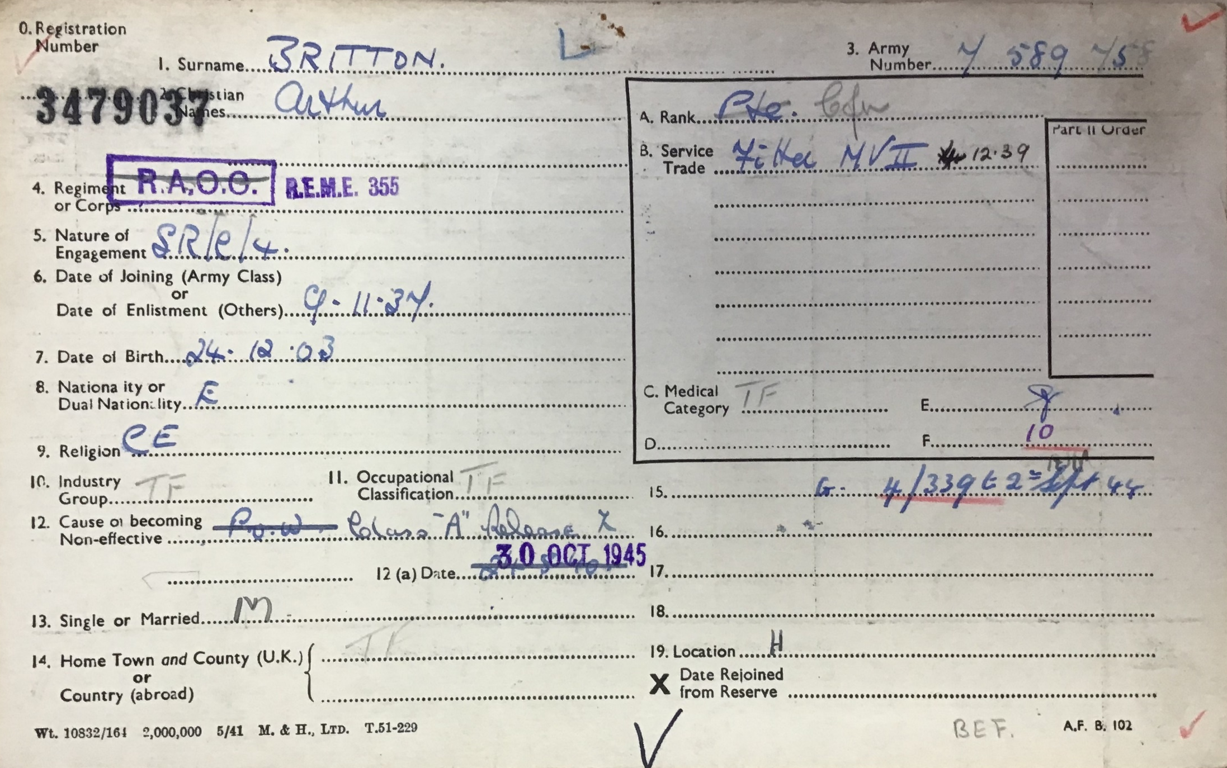
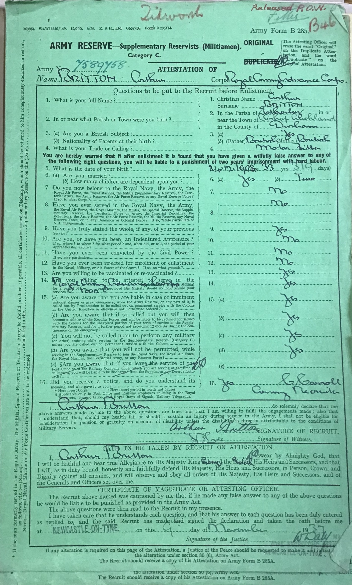
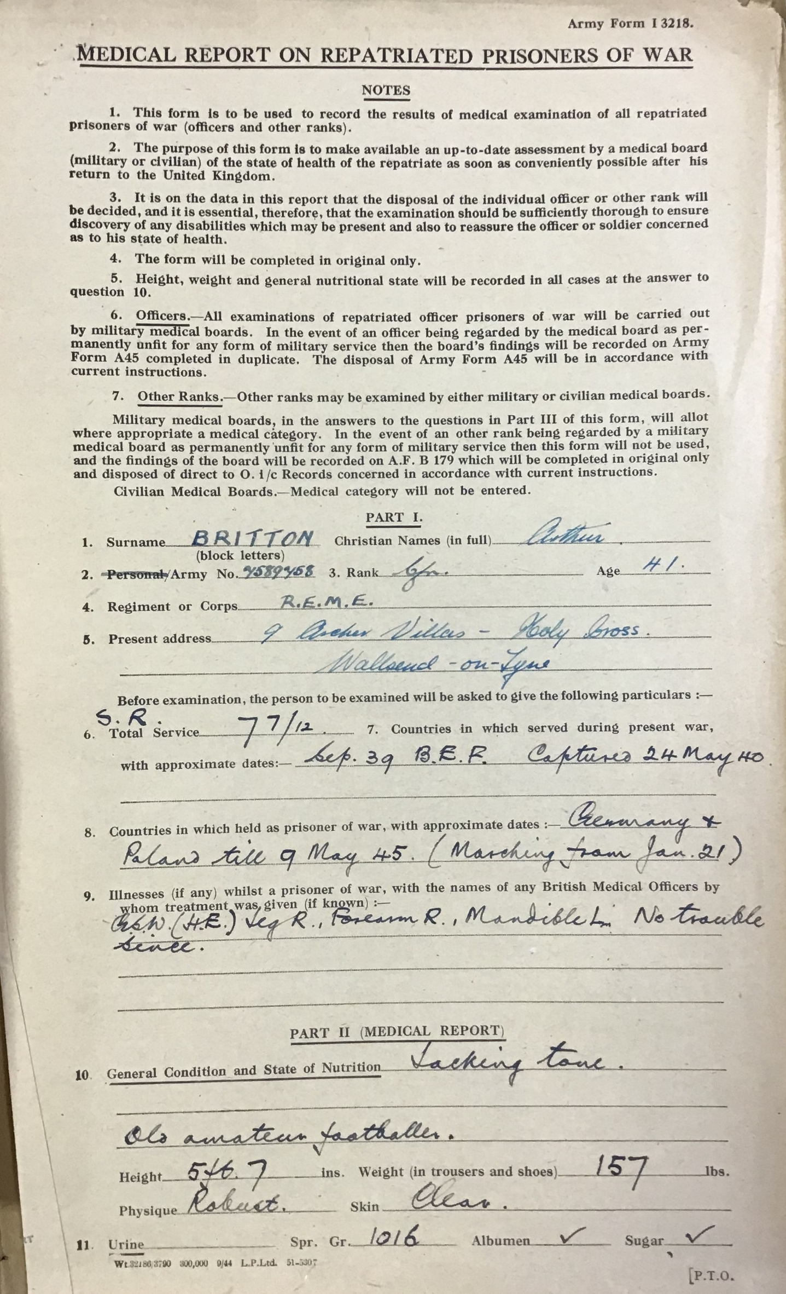
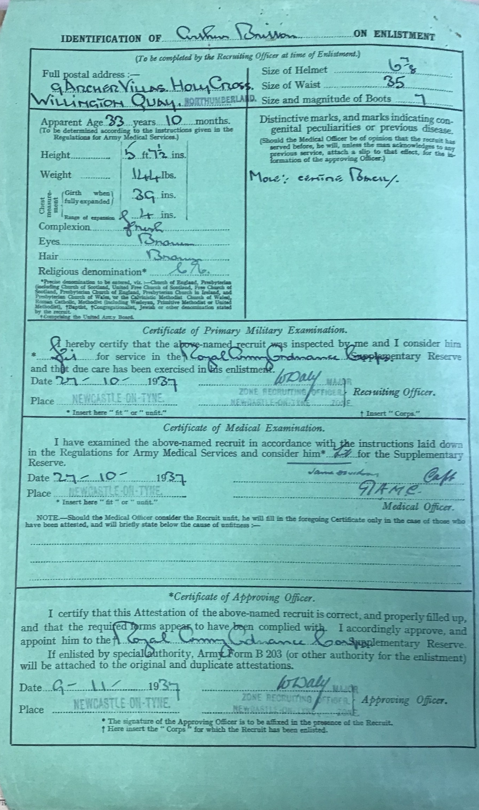
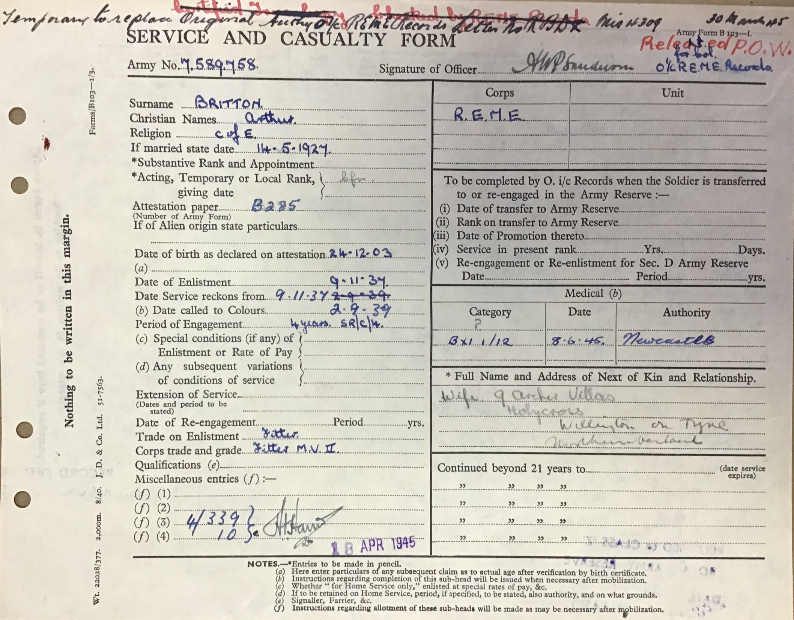
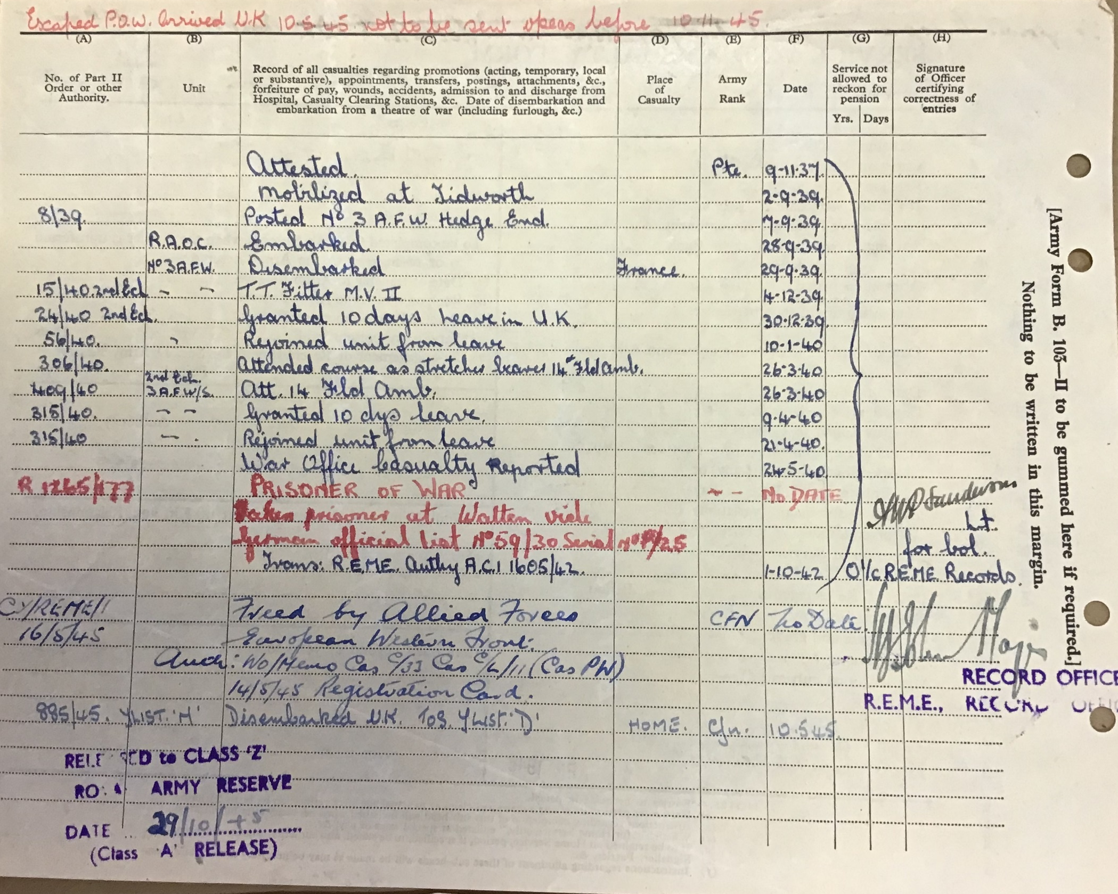

Slide 26
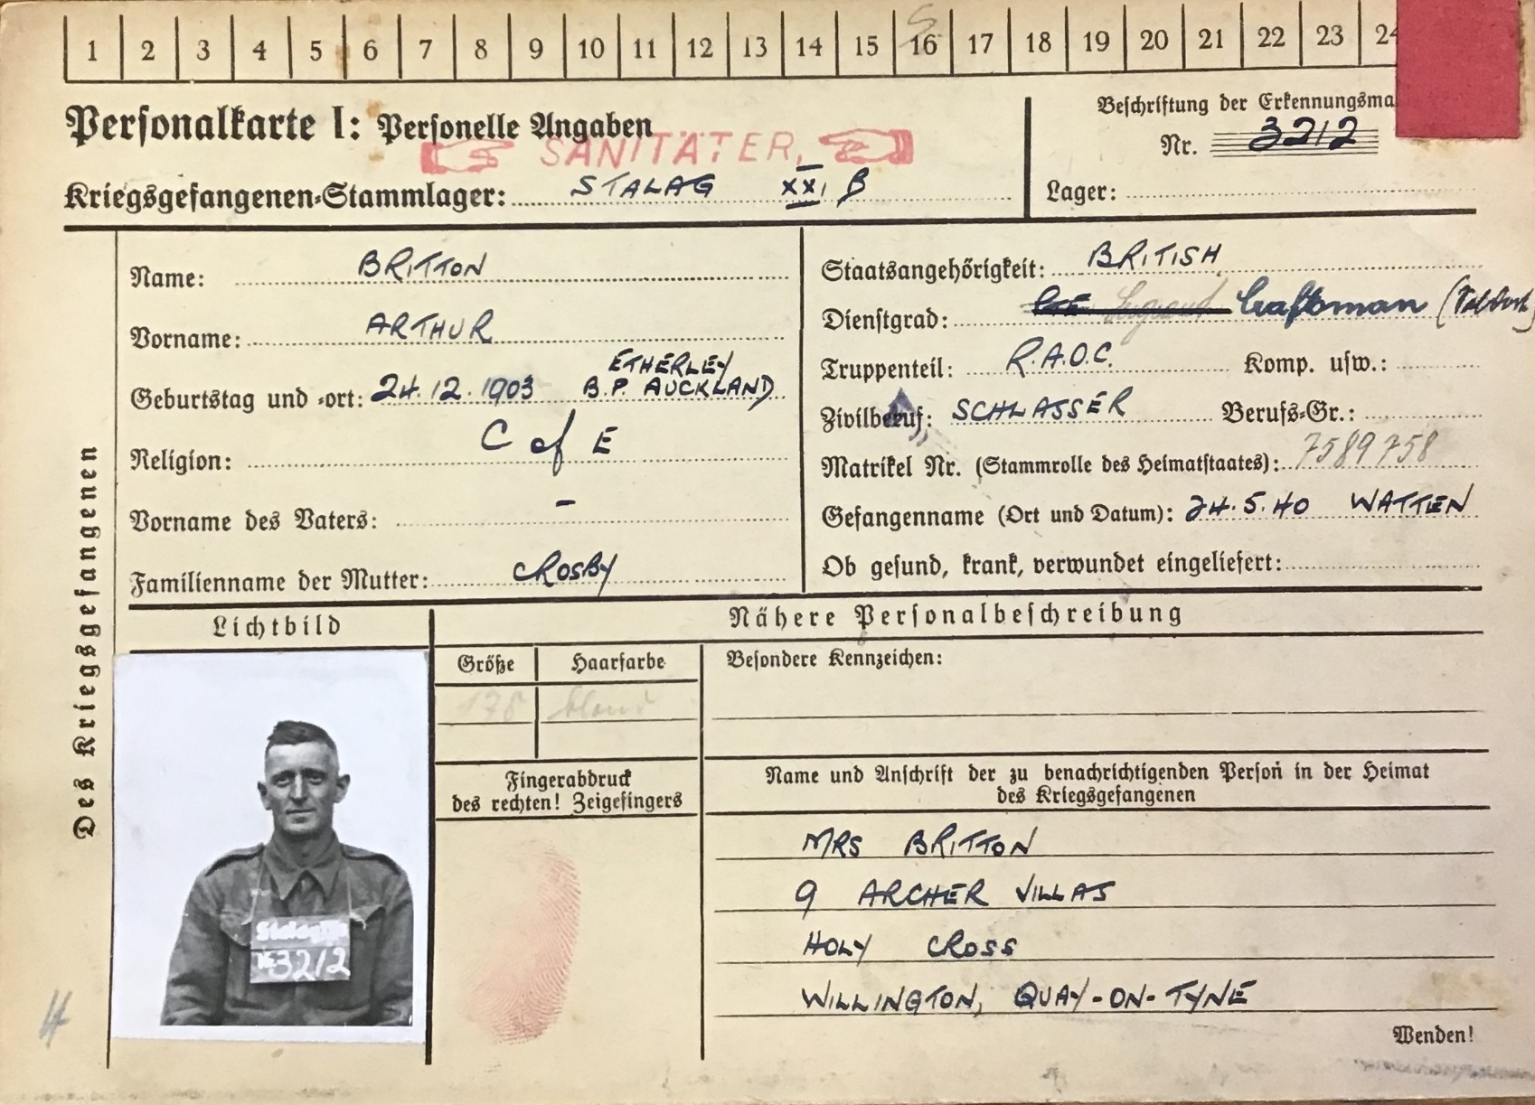
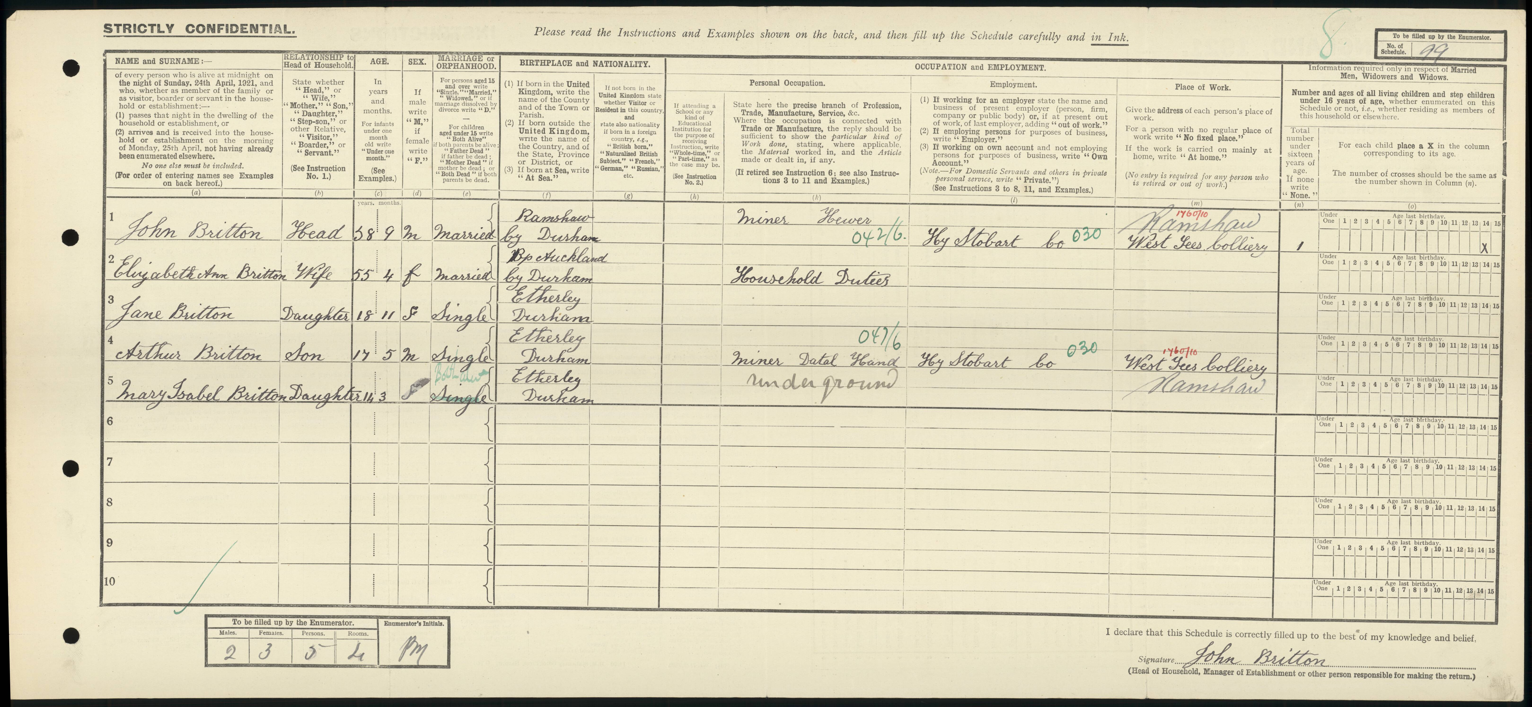
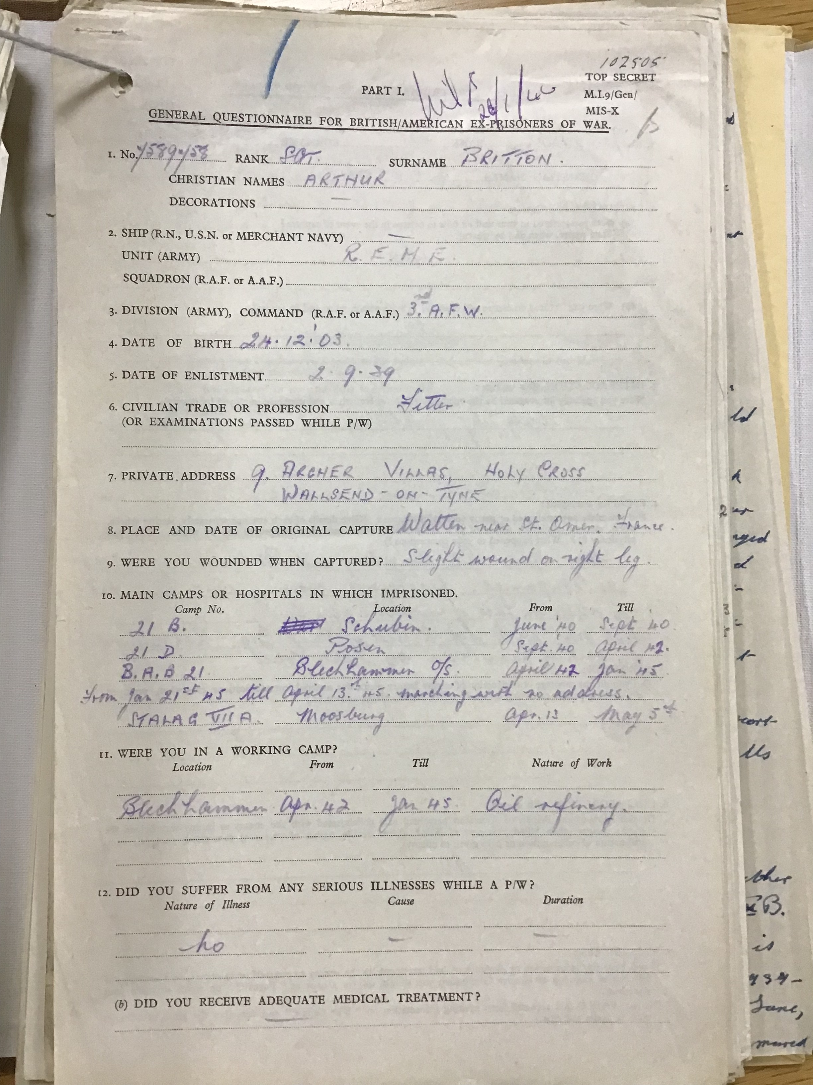
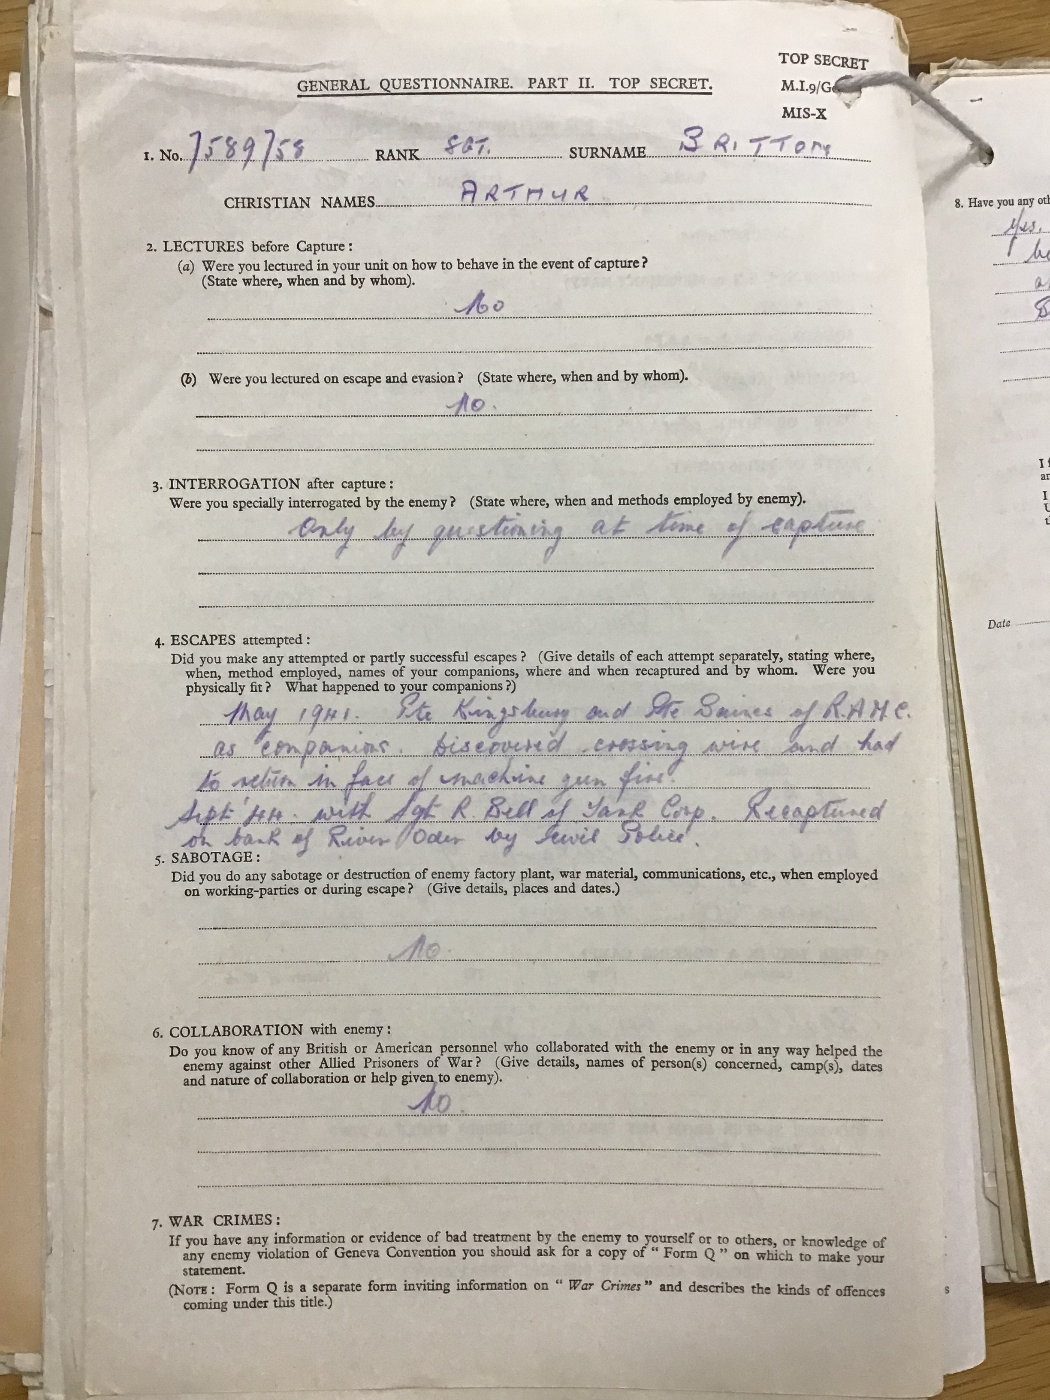
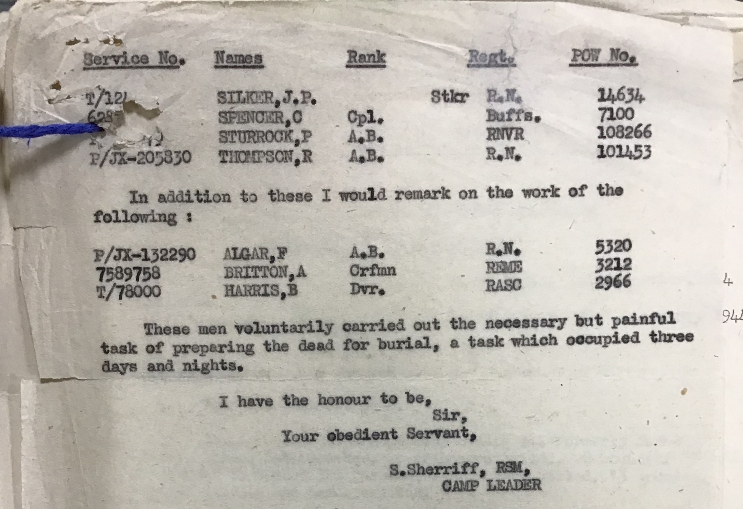

Slide 27
Second World War Unit War Diaries
The number of war diaries is HUGE, much bigger than FWW diaries, which means that they are not all found in one series (like WO 95 for FWW).
Two way of searching for them:
With the name and number of the unit, restricting your search results to records within WO and to a specific date, year or range of years.
If you know the theatre of war where the unit was fighting you can target your search to a specific series. For example, if you know a regiment was fighting in Mesopotamia, you can target your search to the diaries of the Middle East forces. Some examples:
Home forces WO 166
British expeditionary force WO 167
Middle East forces WO 169
North-West Europe WO 171
South-East Asia command WO 172
West Africa forces WO 173

Slide 28
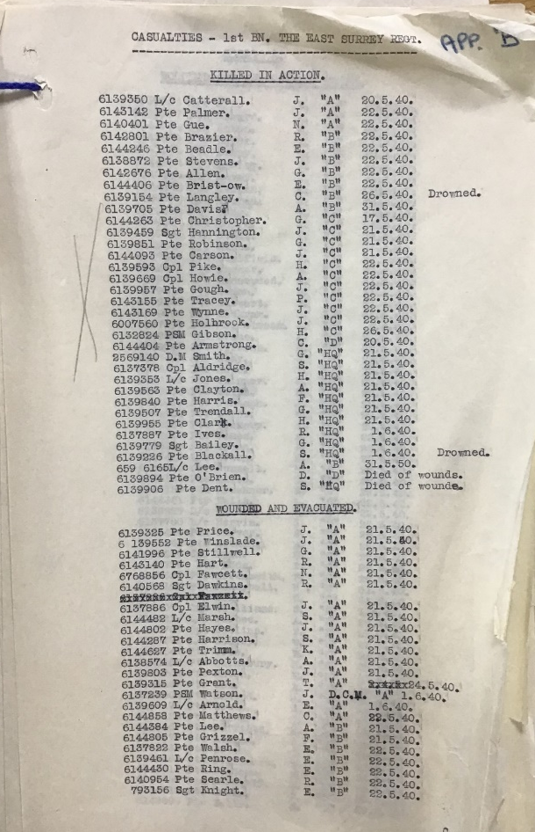
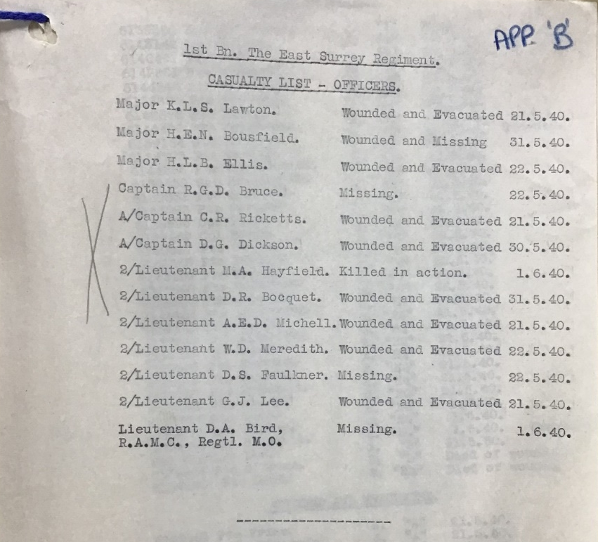
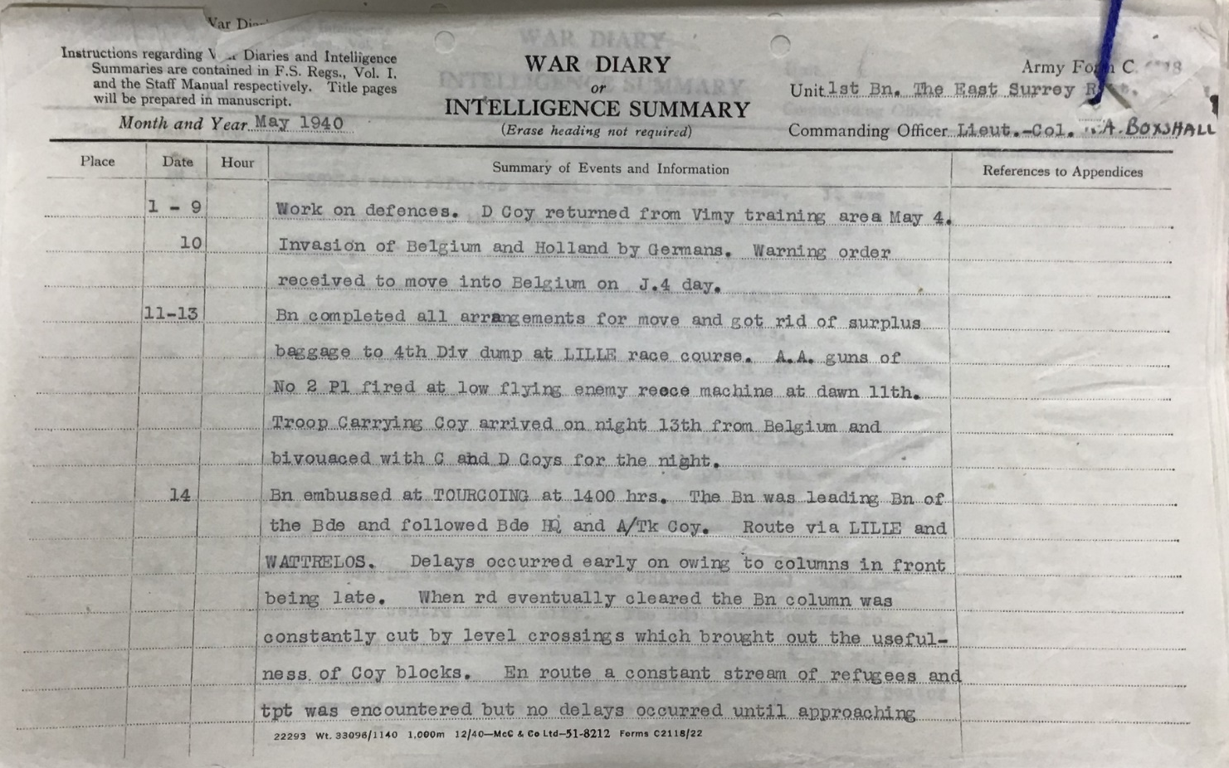
WO 167/827 War Diary of the 1st East Surrey Regiment, September 1939 – June 1940

Slide 29
Headquarters Papers
The records of the military headquarters of each theatre of operation, and of the forces under their command, are the most important sources of information on the planning and conduct of military operations.
British expeditionary force in France 1939-1940 WO 197
North West expeditionary force in Norway 1940 WO 198
Home forces WO 199
Middle East forces WO 201
Military missions WO 202
Allied forces in North Africa, Italy and France 1942-1945 WO 204, WO 228
21st Army Group in Northern Europe 1943-1945 WO 205, WO 229
-a chunk of WO 229 has been digitised

Slide 30
Post-1945 Army Operations
As with previous periods of time, the two types of records at this time were those created by the units of the army itself, and those created by politicians, top-ranking officers etc.
By 1950 though, unit diaries had been largely superseded by alternative forms of record keeping.
Keyword searching can be a good way to begin. Try searching by:
name of operation or campaign (for example, ‘Operation Corporate’)
name of a conflict (for example, ‘Suez crisis’ or ‘Korean War’)
name of army unit. If you are looking records related to specific British Army regiments and other units – these are often recorded in Discovery using abbreviations so try a variety of terms when searching (for example, ‘Regt’ as well as ‘Regiment’, ‘Bn’ as well as ‘Battalion, ‘Bty’ as well as ‘Battery’)

Slide 31
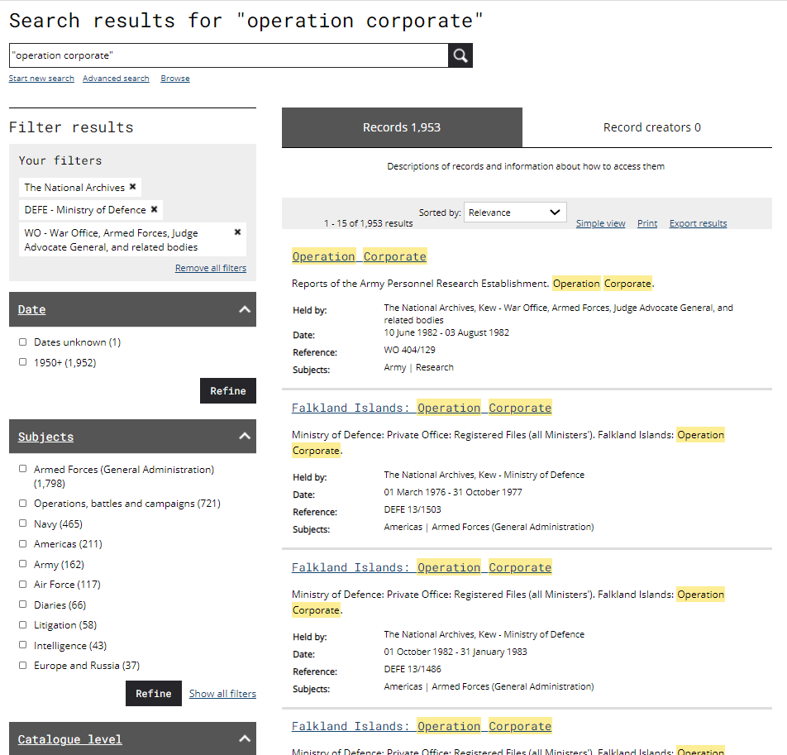
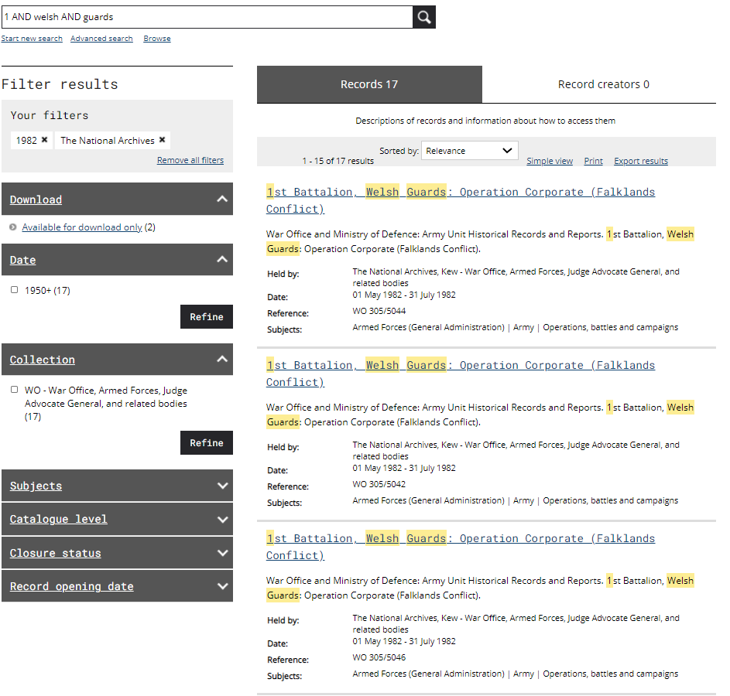
“Operation Corporate” within WO and DEFE

Slide 32
Records of High Command
Search or browse for decision making behind British Army operations, government policy on a specific conflict and all kinds of other high level thinking around the operations, conflicts and wars involving the British Army.
1945-1978 Cabinet minutes CAB 128
1945-1978 Cabinet memoranda CAB 129
1946-1963 Cabinet Defence Committee minutes CAB 131
1937-1962 Combined Operations Headquarters records DEFE 2
(search by name of army unit or operation)
1946-1973 Chiefs of Staff Committee registered files DEFE 11 (search by country or region)
1964-1982 Defence and Overseas Policy Committees
minutes and papers CAB 148

Slide 33
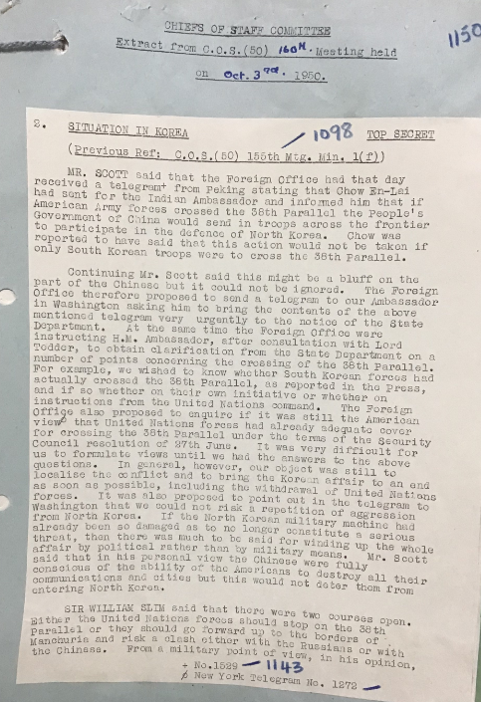
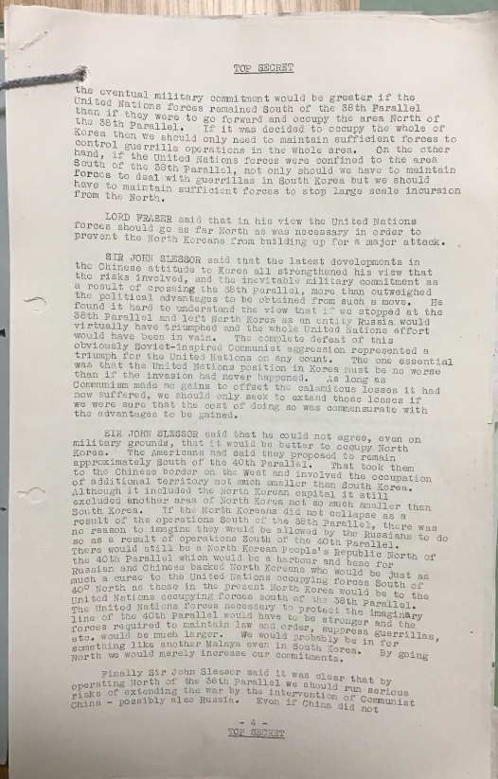
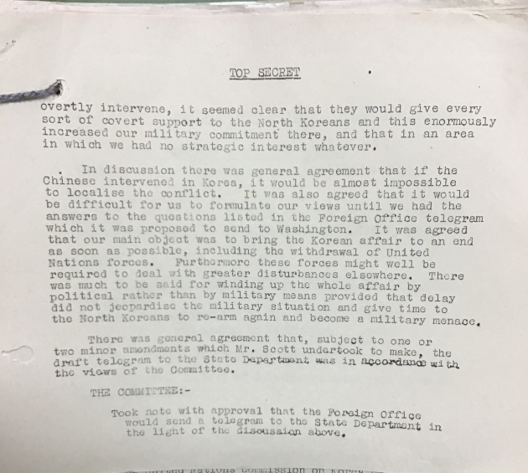
DEFE 11/201 British Commonwealth Forces Korea: situation reports, 1950

Slide 34
Unit Records
From 1946-1950, quarterly historical records and reports replaced the unit war diaries.
Africa: East and West Africa WO 269
Caribbean WO 270
Far East land forces WO 268
Home forces WO 271
Malta: British troops Malta WO 265
Mediterranean: central Mediterranean forces WO 262
Middle East land forces WO 261
Rhine: British Army of the Rhine WO 267
From 1950 onwards, unit historical records and reports are in WO 305.

Slide 35
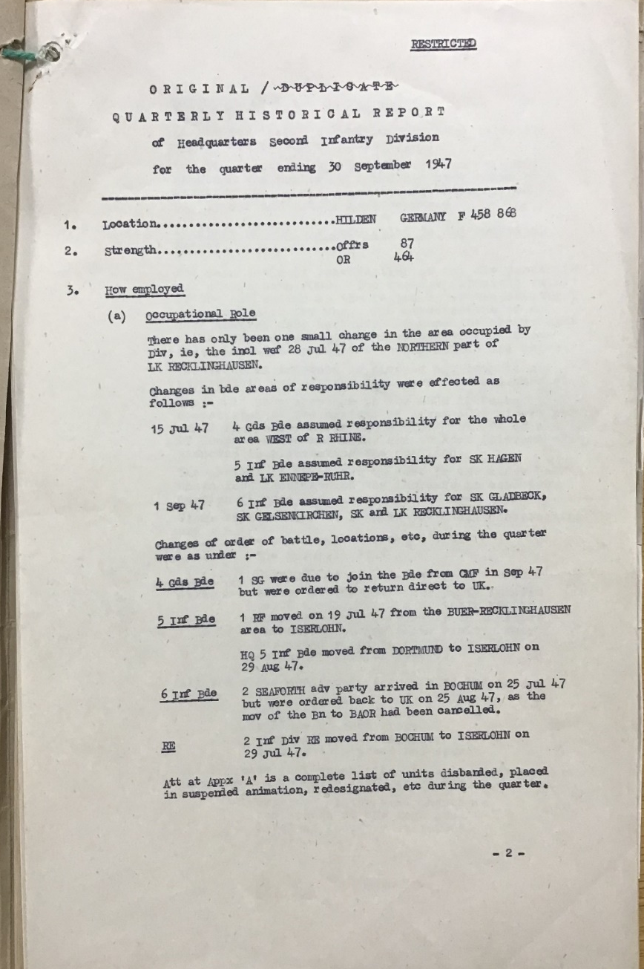
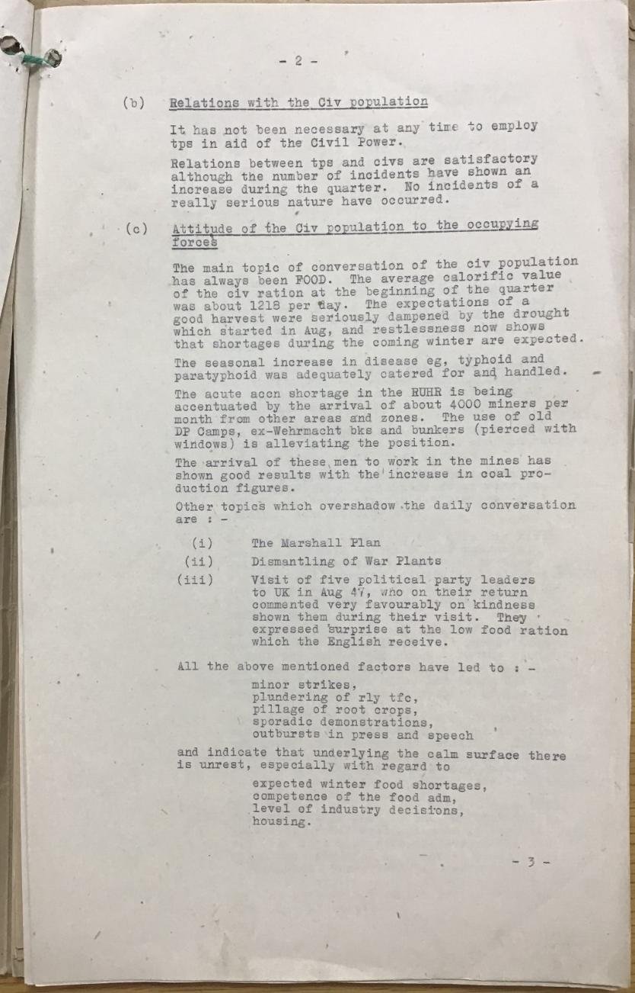
WO 267/144 Quarterly Historical Report; 2 British Infantry Division, July – September 1947

Slide 36
Specific Operations and Campaigns
Palestine, 1945-1948 WO 191 War diaries and headquarters records
Korea, 1950-1953 WO 281 War diaries
WO 308 Historical records and reports
DEFE 12 UN command operation reports
Suez 1956 WO 288 Headquarters papers and war diaries
WO 322 Maps
Falklands War, 1982 WO 305 Unit historical records including war diaries and records of operational activety
The record series listed do not necessarily contain material exclusively on these conflicts but they are amongst the most comprehensive sources.

Slide 37
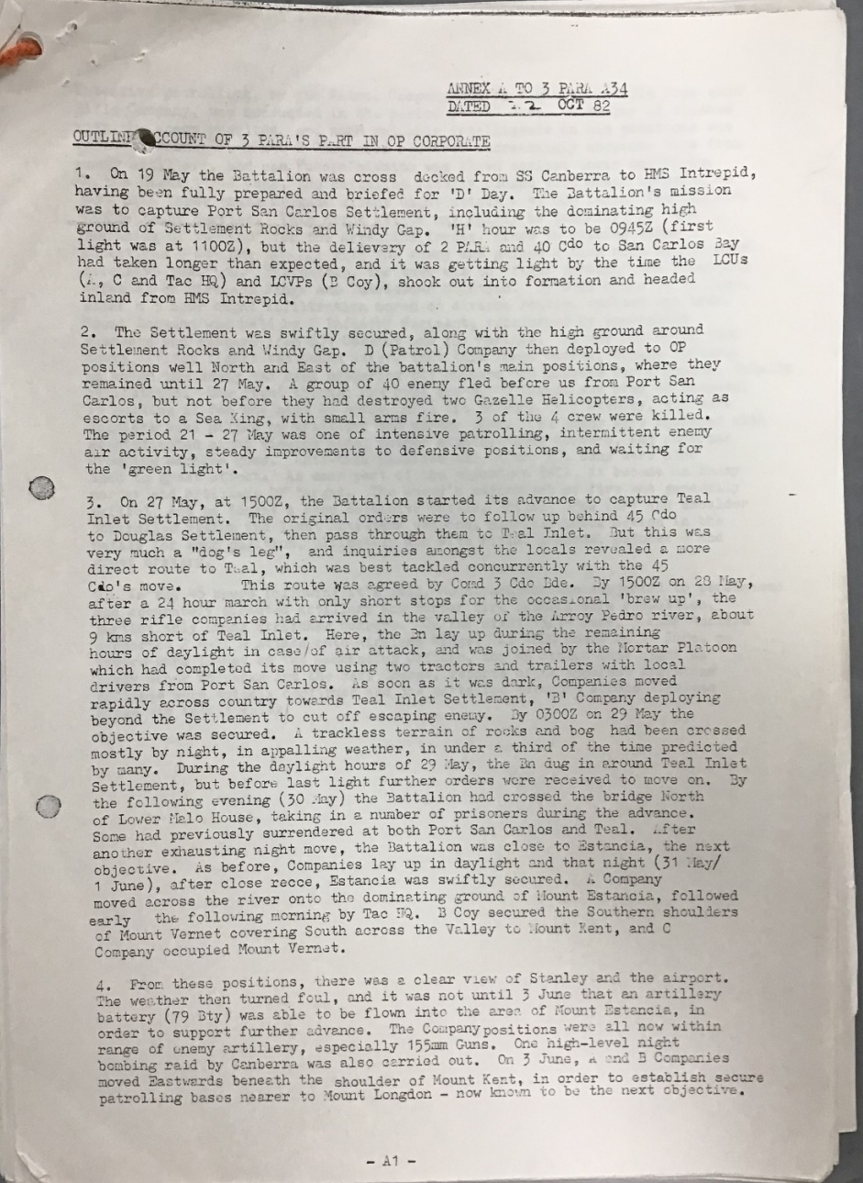


WO 305/5603 Army Unit Historical Record; 3rd Battalion, Parachute Regiment: Operation Corporate (Falklands Conflict)

Slide 38
Records of the Royal Navy, 1914-c.2000

Slide 39


Slide 40
Other personnel records
Registers of seamen’s services (enlisted 1853-1928)
For a Royal Navy rating who served after the First World War there may be a record among the registers of seamen’s services. The online records are for ratings that enlisted during or before 1928. Some of these ratings went on to serve into the 1950s and the online service records reflect this.
Search and download the Royal Navy Registers of seamen’s services for ratings , by name or official number, on our catalogue within the series ADM 188.
These registers of seamen’s services can include information such as:
date and place of birth
ships served on with dates
character and ability
medals awarded
Medal rolls (1793-1972)
Search by name for information about the award of campaign, long service and good conduct medals in the Royal Navy medal roll (ADM 171) using Ancestry. These rolls do not usually contain biographical information. Digital microfilm copies of these records are also available to download and browse from our website free of charge.

Slide 41


ADM 171/165 Award of Medals, 1946-72
ADM 188/1174 Register of Seaman’s Services

Slide 42
Commissioned and Warrant Officers
Naval officers’ service records, 1756-1917 and 1756-1931
Search Royal Naval Officers’ service records on our website (ADM 196) by name for commissioned officers who entered the Royal Navy between 1756 and 1917 or most of the warrant officers who joined the Royal Navy between 1756 and 1931
Records of cadets at the Royal Naval Colleges at Dartmouth and Greenwich, 1876-1968
Among the various records that survive of cadets training to become commissioned officers at the Royal Naval Colleges are the following:
examination results from the Royal Naval College, Greenwich 1876–1880 in ADM 203/21-40
examination results from the Royal Naval College, Greenwich 1907–1957 in ADM 203/41-44
lists of cadets studying at the Royal Naval College, Dartmouth 1931-1942 in ADM 203/104-137
lists of cadets studying at the Royal Naval College, Dartmouth 1946-1968 in ADM 203/151-198

Slide 43

ADM 196/87/27 Service Record for Admiral John Jellicoe

Slide 44
Ship’s Records
Ships’ logs from 1799 onwards
The various types of officers’ logs discussed above were, by the mid 19th century, superseded by ships’ logs and these records are held in series ADM 53.
Ships’ captains would inspect the logs weekly and they were then sent to the Admiralty.
Consult the ADM 53 series description for information on what the records contain.
Click on the series reference to search for ships’ logs by ship’s name and date in ADM 53
Medical officers’ journals 1785-1963
Medical officers, sometimes referred to as surgeons, on board ship were required to keep a general journal on the health of the ship’s company.
Click on the series reference to search for surviving medical officers’ journals in ADM 101, a record series which also contains other kinds of Admiralty medical journals. Search by:
name of ship
name of sick or injured person
name of sickness, disease or injury (for example, scurvy, consumption, cough, broken leg)

Slide 45

Log Book for HMS Naiad log book, 22 May 1941, during the Battle of Crete
ADM 53/114750

Slide 46
Admiralty Registry System in ADM 12
ADM 12 the basics – the indexes and digests volumes in ADM 12 series are extended from 1793 to 1958, these are the key means of reference to the Admiralty and Secretariat correspondences in the following series:-
ADM 1 - Admiralty correspondence (1660-1976)
ADM 2 - Admiralty out-letters (1656-1859)
ADM 3 - Admiralty minutes (1657-1881)
ADM 116 - Admiralty Record Office cases (1852-1965)
ADM 137 - Records used to compile the official history of the First World War
ADM 199 - War History Cases and Papers Second World War

Slide 47
ADM 12 indexes and digests arrangement
The index volumes – the alphabetical indexes contain entries by name for:-
    Commissioned and Warrant Officers
    Ratings
    Persons of distinction
    Royal Navy ships (in red ink)
    Foreign naval and Merchant vessels (in black ink)
    Anyone who wrote to the Admiralty
Notes:
The index volumes – the alphabetical indexes contain entries by name for
(Click) Commissioned and Warrant Officers
(Click) Ratings
(Click) Persons of distinction
(Click) Royal Navy ships (in red ink)
(Click) Foreign naval and Merchant vessels (in black ink)
(Click) Anyone who wrote to the Admiralty

Slide 48


ADM 12/1757
Notes:
(Click) Once we have ordered appropriate ADM 12 index volum for Repulse,
(Click) We found reference relating to Awards in this case Admiralty code ‘HA68/42’

Slide 49



Notes:
Here is the ADM 1/12315, as can be seen on the right image it’s show letter of recomendation by Captain William Tennant of the Repulse to
(Click) ‘the names of the following officers and men, of whom several did not survive, for outstanding gallantry, zeal and devotion to duty during Repulse’s last action on December 10, 1941’

Slide 50
Records of the Royal Air Force

Slide 51

Personnel Records
Records mostly date from before 1939. They cover service histories of officers and other ranks, and medals. There are some Second World War casualty reports as well.
Operational Records
There are many kinds of operational records, especially in wartime. The records cover single aircraft sorties up to large-scale campaigns
Catalogue searching will often find sources but it helps to follow the structure of the RAF in wartime. All the operational records fit somewhere into a hierarchy.
Operations Records Books (ORBs) a key resource, covering 1911-1963
AIR 23/6125 German attack on Crete, 1941

Slide 52


Service record for Albert Ball (killed in action May 1917)

Slide 53
Sample RAF operational organisation, 1939-45

Slide 54

616 Squadron August 1941 (Bader’s last sortie)
AIR 27/2126/35

Slide 55
Thank you
Will Butler
The National Archives
Kew, Richmond
TW9 4DU

